Slide 1
Nicola Lester
BOOKS FOR RECONNECTION
SESSION 4
Tending to and mending our broken hearts
consultancy@nicolalester.co.uk

Slide 2
AIMS
To reflect on the impact of working with trauma
To explore what we know about ‘burnout’
To consider ways of addressing ‘burnout’
To reconnect with the meaning of our work

Slide 3
What do you know about ‘burnout’?
What 5 words come up for you when I use the word ‘burnout’, write these into the chat?

Slide 4
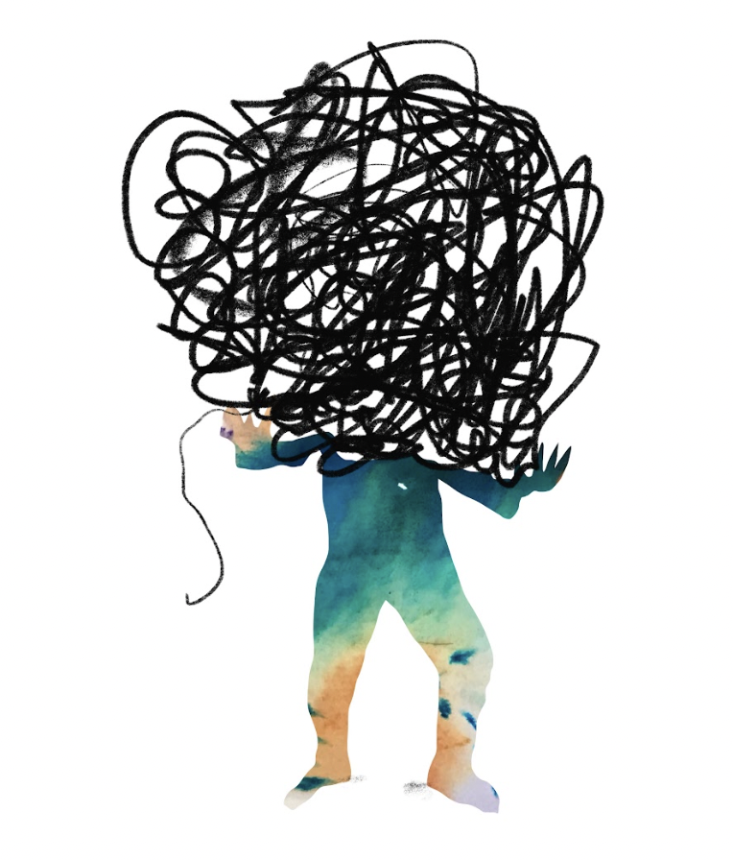
Defining the terms
Burnout
Compassion fatigue
Vicarious trauma

Slide 5
burnout
A state of physical and emotional exhaustion, characterised by diminished motivation, pervasive helplessness, frustration, a sense of failure, loss of power and agency, a lack of value and appreciation, increased loneliness and detachment, withdrawal and isolation, overwhelm and procrastination.
Like all forms of stress, burnout impacts both our physical and mental health meaning that we are more susceptible to illness.

Slide 6
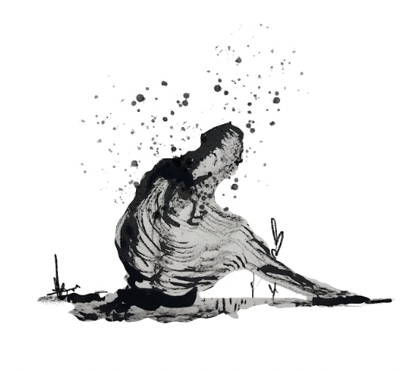
Compassion fatigue
‘a state of exhaustion and dysfunction biologically, psychologically, and socially as a result of prolonged exposure to compassion stress and all it invokes’
Figley, C (1995) ‘Compassion fatigue: Toward a new understanding of the costs of caring’ p. 253

Slide 7
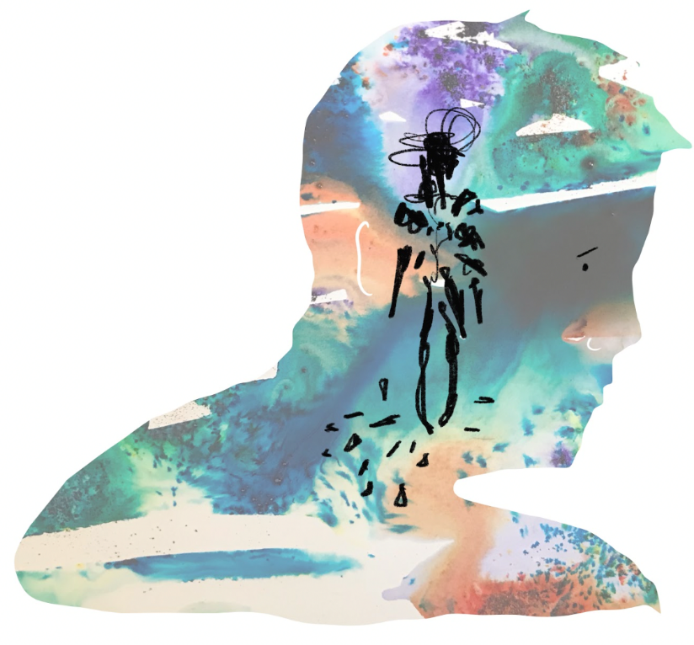
Vicarious trauma
‘The personal transformation experienced by those who work with trauma’
McCann, L and Pearlman, L (1990) ‘Vicarious traumatization: a framework for understanding the psychological effects of working with victims’ p.199

Slide 8
What does ‘burnout’ tell us about:
Anger, frustration, courage and the need for reconnection or change?
What we need and what we care about?

Slide 9
Reflecting on ‘frustration’
Does frustration seem like a good thing or a bad thing?
Productive or disruptive?
What is frustration exactly, and what causes it?
What can you do about it?
‘The Burnout workbook’ (p. 31)
Emily and Amelia Nagoski

Slide 10
Books, self help and courses
Feeding our curiosity, developing understanding and self-awareness
Contributing to overwhelm, confusion and noise

Slide 11
Books for reference
‘Burnout’ and ‘The Burnout Workbook’ - Emily and Amelia Nagoski
‘The Super-helper Syndrome’ - Jess Baker and Rod Vincent
‘Untamed’ - Glennon Doyle
‘The Gifts of Imperfection’- Brené Brown

Slide 12
Managing fatigue
Awareness, understanding (knowing what works for you)
Kindness and compassion
Judgement, advice, more things ‘to do’

Slide 13
Windows of tolerance (dysregulation to regulation)
Remember we each have a ‘window of tolerance’- when we are in our ‘window of tolerance’, we can think clearly, problem solve, take perspective, be curious, and generally perform at our best.
However, sometimes we can be pushed outside of our window of tolerance into survival model when our ‘thinking brain’ gets switched off and instead we get can move into flight, fight or freeze responses instead (i.e. avoidance, frustration, anger, defensiveness or being unable to take action or make decisions).
Take some time to reflect on what pushes you outside of your window of tolerance? What do you need to move back inside it?

Slide 14
Control and acceptance: Practical Activities
Sort your stressors
Planful problem solving
Practicing positive reappraisal and redefining winning
The Upside of stress

Slide 15
Sort your stressors
There are two types of stress, those you can control and those you can’t.
Check in with all of the things which are causing you stress and notice which ones you have immediate control over and which ones you don’t. Make a list.
‘The Burnout workbook’ (p. 34)
Emily and Amelia Nagoski

Slide 16
Planful problem solving
Choose some of the items on the list of stressors you can control and create an action plan for these.
‘The Burnout workbook’ (p. 36)
Emily and Amelia Nagoski

Slide 17
Practicing positive appraisal
Positive reappraisal involves recognising that the challenge you’re facing is worth it. It means acknowledging that the effort, discomfort, frustration, unanticipated obstacles, and even repeated failures have value - not just because they are steps toward a worthwhile goal, but because you reframe difficulties as opportunities for growth and learning.
What are some of your biggest challenges with uncontrollable stressors right now?
How are these challenges also opportunities for growth and learning? (redefining winning)
‘The Burnout workbook’ (p. 38-39)
Emily and Amelia Nagoski

Slide 18
The upside of stress

Slide 19
Reducing resentment: establishing boundaries
What’s okay? what’s not okay?
Think of a situation when you last experienced a sense of ‘resentment’ after completing a piece of work or helping someone. Take some time to reflect on what happened. What boundaries could you create to reduce the possibility of this happening again?
Keep repeating this exercise until you have at least 5 things on your list.
Or, think of someone you respect, who is good at establishing and protecting their boundaries. Someone who does it in a skilled and assertive way. Think of how and when they do this and what the results are. If you feel comfortable, ask them how they protect their boundaries.

Slide 20
Permission to set boundaries: the definition of ‘helping’
“Make something easier or possible for someone by offering them resources, information, expertise and, or support, when they both want and need this.”
‘The Super-Helper Syndrome’ (p. 22)
Jess Baker and Rod Vincent

Slide 21
4 forms of helping
Resources
Information help
Expert help
Supportive help

Slide 22
‘assumptive’ versus ‘responsive’ helping
Assumptive help isn’t asked for; responsive help is.
However, sometimes assumptive help is needed, people can’t or won’t ask for help. Remember though it requires sensitivity to make the right approach and sometimes offering choices and providing information about what you can do can be useful.

Slide 23
Reconnecting with meaning in our work
“When we find meaning in our work, we are more motivated and more productive.”
‘The Super-Helper Syndrome’ (p. 192)
Jess Baker and Rod Vincent
“Meaning is the nourishing experience of feeling like we are connected to something larger than ourselves. It helps us thrive when things are going well, and it helps us cope when things go wrong in our lives.”
‘The Burnout workbook’ (p. 50)
Emily and Amelia Nagoski

Slide 24
The benefits of ‘helping’
Helping others helps you:
Make better judgements
Enjoy a warm glow
Reduce stress
Reduce anxiety
Feel hopeful
Build courage
Bring motivation
Increase energy
Feel euphoric
Boost self-worth
‘The Super-Helper Syndrome’ (p. 184)
Jess Baker and Rod Vincent

Slide 25
The benefits of ‘helping’
“When we care for others it changes our biochemistry, activating systems of the brain that produce feelings of hope and courage”
Kelly McGonigal, Health Psychologist, Stanford University in ‘The Super-Helper Syndrome’ (p. 184)
Jess Baker and Rod Vincent

Slide 26
Envisioning ‘healthy helping’: practical activity
Write your own story of all the benefits that helping brings to you. Remember all of the times when you’ve felt great about helping. Don’t be afraid to be bold in claiming everything you have to gain.

Slide 27
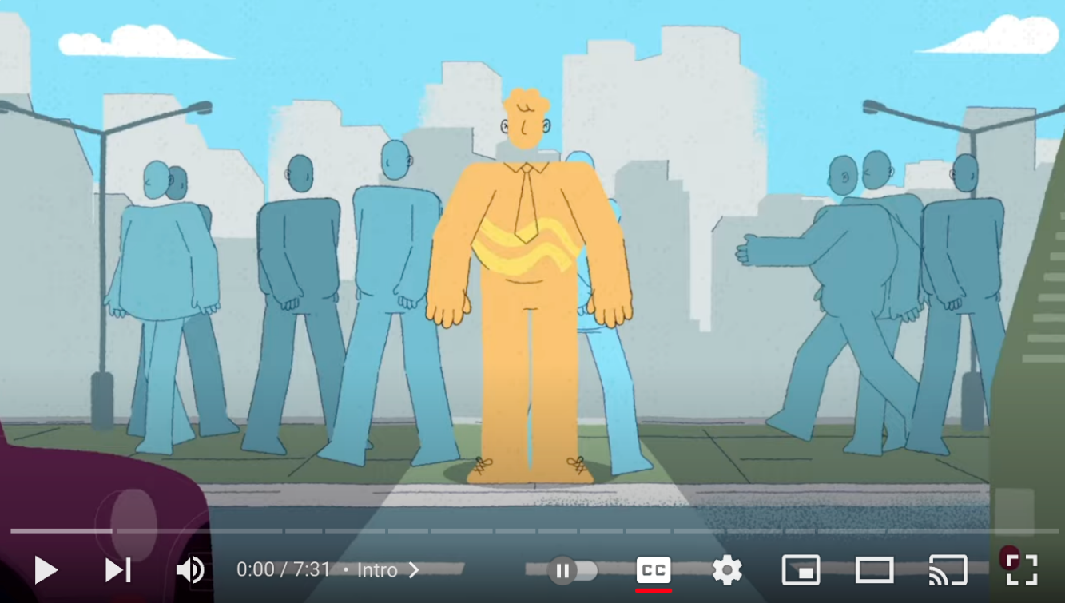
Reconnecting with our ‘something larger’: why?
It is not about ‘what’ we do, or ‘how’ we do it, but ‘why’ we do it.
Drawing on lessons from marketing and business - Simon Sinek’s ‘Start with Why’, watch this video and then take some time to think about and develop your ‘why’. You may need to start by reflecting on ‘what’ you do and ‘how’ you do it before being able to trace back to ‘why’.

Slide 28
Thank you for joining the session

