Slide 1
Nicola Lester
Developing Trauma Informed Practice
SILVER LEVEL
consultancy@nicolalester.co.uk

Slide 2
aims
Developing therapeutic skills for practice: ‘creating moments’
Creative ways of working: when words are difficult to find
Supporting families (including children and young people)
Making SENSE of psychological trauma: structuring trauma informed interventions
Using the SENSE model in practice
Trauma informed approaches to measuring impact
Understanding the impact of complex trauma
Understanding and responding to vicarious trauma: it will never be enough

Slide 3
DEVELOPING THERAPEUTIC SKILLS
Remember that a trauma informed approach is not about ‘treating trauma’ or focusing on someone’s experiences of trauma (unless they choose to share them).
A trauma informed approach is about:
Supporting people to cope
Providing a sense of safety
Restoring a sense of control by offering them choices wherever possible
Recognising their strength and resilience (asking ‘what’s right with with you?’)
Taking the time to understand how someone is making sense of the world around them (not making assumptions but being curious)
Establishing a sense of connection to family, friends, professionals and the wider community
Creating moments of hope, optimism, comfort and connection

Slide 4
KEY THERAPEUTIC SKILLS FOR TRAUMA INFORMED PRACTICE

Slide 5
BEARING WITNESS TO DISTRESS
One of the most important aspects of a trauma informed approach is the ability and willingness to bear witness to distress and to remain present, no matter how difficult it is.
Bearing witness offers validation and acknowledgement but most importantly it reminds someone that they are not alone.

Slide 6
EMPATHY, SYMPATHY AND IDENTIFICATION: UNDERSTANDING THE DIFFERENCES
Empathy is simply listening, holding space, withholding judgment, emotionally connecting, and communicating that incredibly healing message of you’re not alone
Brene Brown

Slide 7
DEMONSTRATING EMPATHY IN PRACTICE
Putting aside your own viewpoint and trying to see things from the other person’s point of view
Validating their perspective (demonstrating that you understand how they are thinking and feeling)
Listening and checking your understanding of their perspective

Slide 8
RESPONDING TO ACUTE DISTRESS
When someone is experience acute levels of distress, try to engage them by:
Asking them about their immediate needs and support them to meet these
Helping them to understand the impact of stress and trauma on both their mind and body
Using this information to provide them with reassurance and support
Connecting them with their social support networks (this may start with working with them to identify who are good/positive sources of support)
Identifying what helps them to cope and feel better (or ‘less worse’)

Slide 9
MANAGING OVERWHELM
Dissociation is one way in which the mind copes with too much stress and leads the person to become disconnected from the world around them.
When you are working with someone who is distressed it is really important to keep them connected to the ‘here and now’.
These are known as ‘grounding’ techniques, where the aim is to try and bring someone back to the present.
Providing information about different techniques can be useful to recreate a sense of control that someone is able to manage their emotions.

Slide 10
EXAMPLES OF TECHNIQUES TO MANAGE STRESS, FEAR AND ANXIETY
The 5-4-3-2-1 method
Working backward from 5, use your senses to list things you notice around you. For example:
5 things you hear
4 things you can see
3 things you can touch
2 things you can smell
1 thing you can taste

Slide 11
EXAMPLES OF TECHNIQUES TO MANAGE STRESS, FEAR AND ANXIETY
The Butterfly Hug
This is a technique used in trauma focused treatment to reduce distress (and is often used with children who have been affected by trauma).
Wrap your arms around yourself so that each hand touches the opposite arm or shoulder, then move your hands like the wings of a butterfly in an alternating rhythm (left and then right, lightly, like the wings of a butterfly)

Slide 12
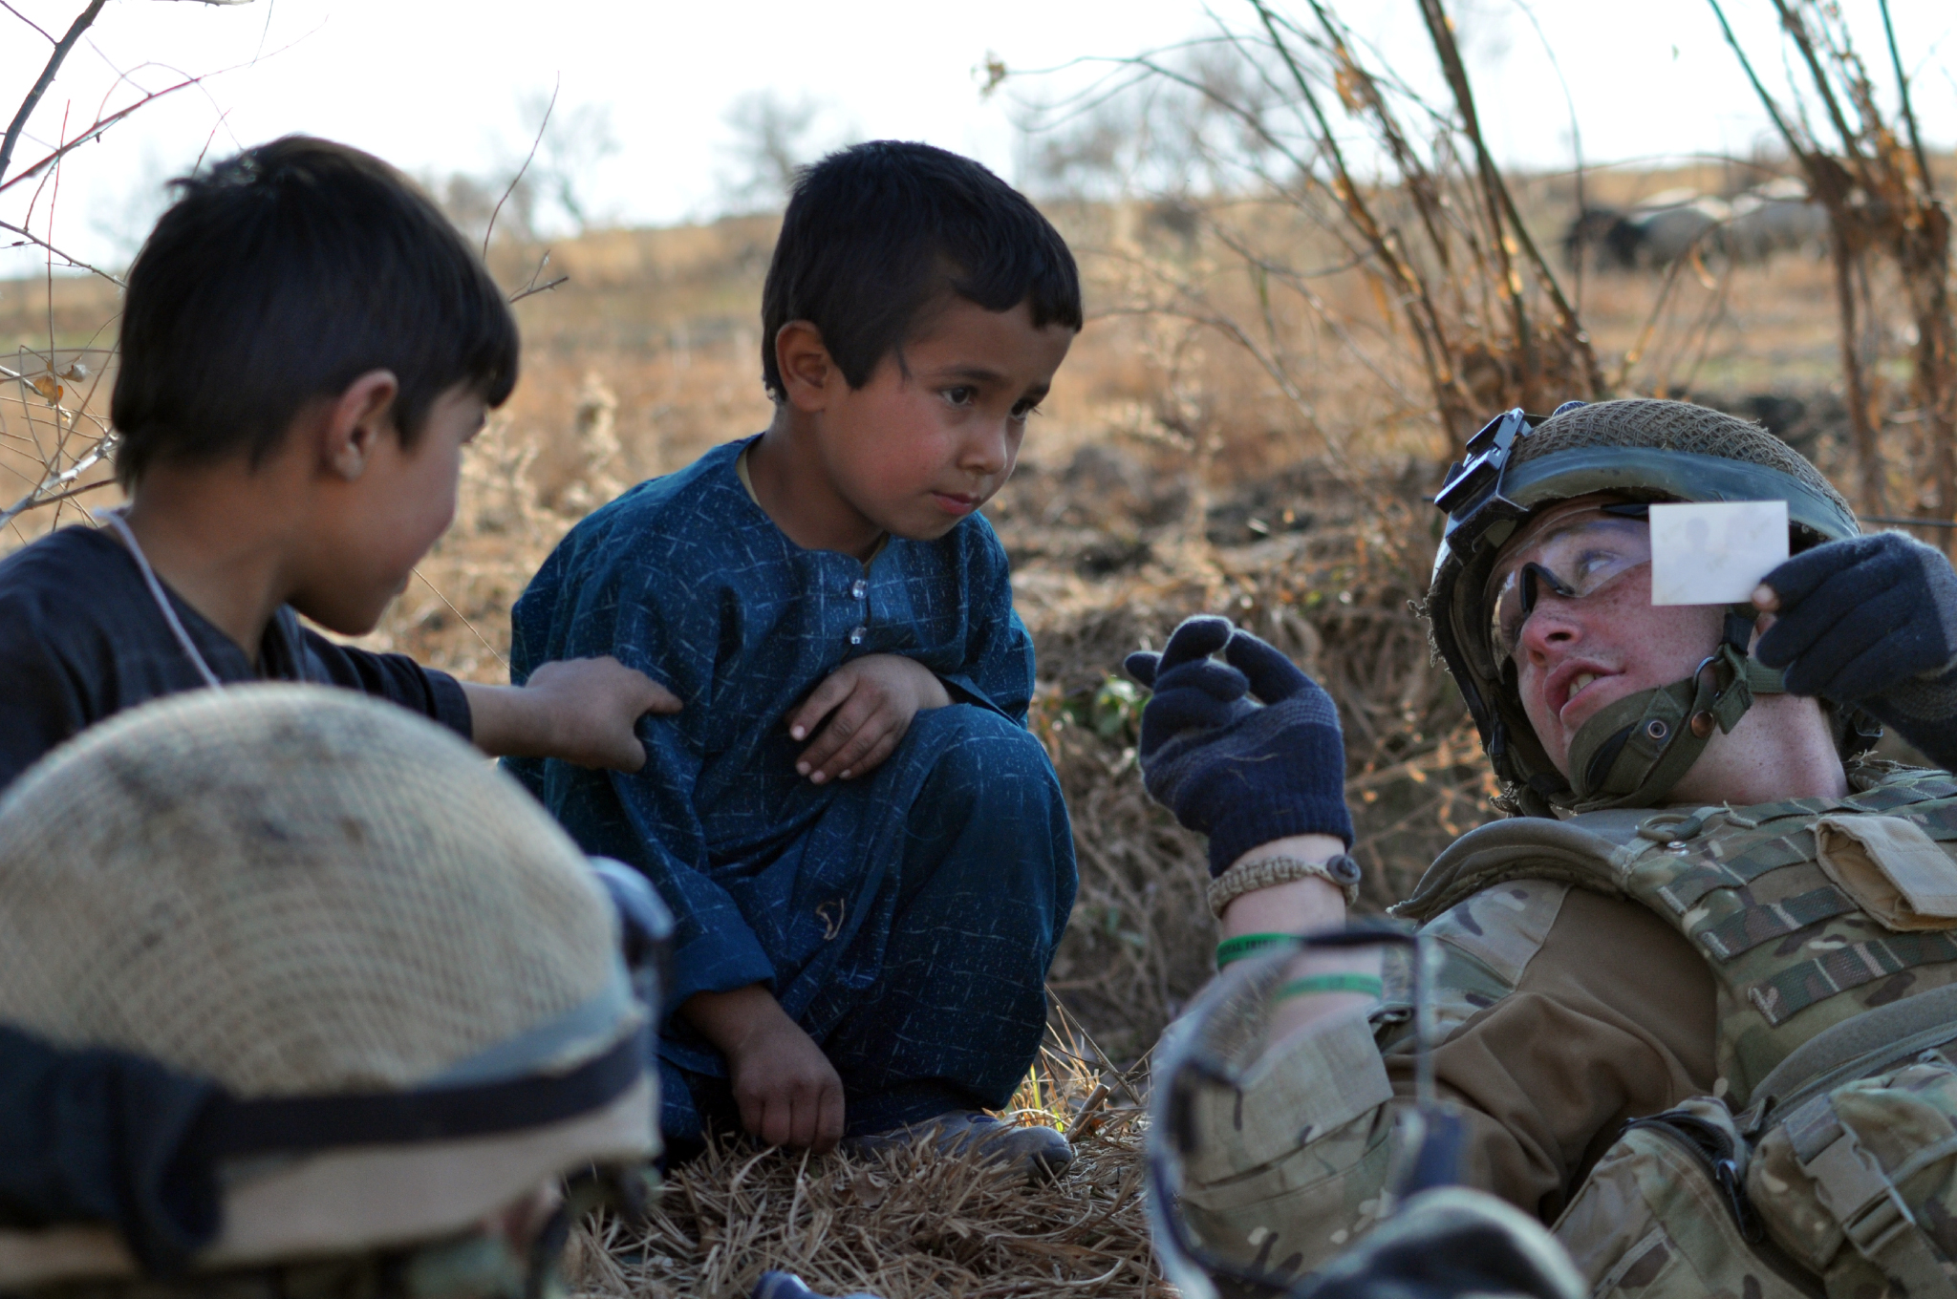
‘see, look, wonder’: seeking to understand experiences

Slide 13
‘see, look, wonder’: practical activity

Slide 14
‘Listen, hear, wonder’: asking the ‘right’ questions
‘When people talk, listen completely. Most people never listen.’
Ernest Hemmingway
Check understanding by asking questions, remaining curious and seeking to understand
Try not to assume and if you do, share and clarify
The importance of openness, honesty, transparency and authenticity

Slide 15
‘Not knowing’
It is okay to ‘not know’ and to not have all of the answers. Being honest about this is important to maintain a relationship based on honesty and transparency. Understanding is generated by asking questions and creating knowledge.
Survivors of atrocity of every age and every culture come to a point in their testimony where all questions are reduced to one, spoken more in bewilderment than in outrage: Why? The answer is beyond human understanding.
― Judith Lewis Herman

Slide 16
Saying the ‘wrong’ thing and ‘sorry’
People often worry about saying the ‘wrong’ thing, I believe that if what you have said is well-intentioned and comes from a place of compassion and kindness, it will not be ‘wrong’. However, if what you have said doesn’t seem to work for someone or if it does not have the intended effect, don’t be afraid to acknowledge this and simply say ‘sorry’.
In almost all cases this will repair and strengthen the therapeutic relationship.

Slide 17
A note about self-care when working therapeutically
There can be no greater privilege than being allowed to bear witness to someone’s distress. However, this comes at a cost to ourselves and it is important to reflect on our own ‘trauma jars’ and think about what we need from those around us to sustain the commitment to our work.

Slide 18
Creative ways of working: when words are difficult to find

Slide 19
art
Can provide:
a safe way of expressing emotions
an opportunity to feel in control and make choices (i.e. about materials, colours or what to create)
a way to make sense of and understand feelings
the release of dopamine (allows someone to feel pleasure, satisfaction and motivation)

Slide 20
Making art accessible
Collage (pictures, magazines, textiles)
Mark making (swirls, dots, dashes, smudging)
Colouring books (‘therapeutic colouring’)
Making your own tools (i.e. using sticks to paint)
Using your none dominant hand to work (take the pressure off, it’s not your fault if it’s ‘no good’)

Slide 21
Expressing feelings
The ‘five word’ story may provide a way to:
reduce a sense of overwhelm
attribute a name to feelings
make sense of experiences
record experiences (making journaling more accessible)

Slide 22
Using illustrations to make sense of feelings
Illustrations can be used to help people to make sense of their feelings
They can offer a ‘safer’ way of expressing and talking about emotions
Illustrations can also prompt conversations around how to connect someone with support and provide them with a sense of agency to create changes for themselves
They can also act as lasting visual reminders of strength and resilience

Slide 23
Therapeutic creative writing
Freewriting. Paying attention to and creating an order to thoughts and feelings
Writing a gratitude list. Get specific and develop a daily practice.
Unburden yourself. Write a letter to someone or about something.
Pay attention to anxiety. Give permission to yourself to think and write about:
The worst outcome
The best outcome
The most likely outcome

Slide 24
Therapeutic creative writing
Poem by Yasmine, age 13.
Survivor of the Manchester Arena attack

Slide 25
Therapeutic Illustrations: the story of a young refugee

Slide 26
Using therapeutic resources: a case study from Peterborough Rape crisis
Resources can be used to enhance the therapeutic effect of our engagement by:
Supporting coping
Promoting self-care
Strengthening the relationship between caseworker and client (providing a means of demonstrating care, kindness and compassion)

Slide 27
Using therapeutic resources: a case study from Peterborough Rape crisis
Aromatherapy oils selected by the client
Weighted blankets (for those times when the client may need physical affection)
Making friendship bracelets and selecting charms to remind them of their strength and resilience
Reciprocal badge making (creating lasting messages)

Slide 28
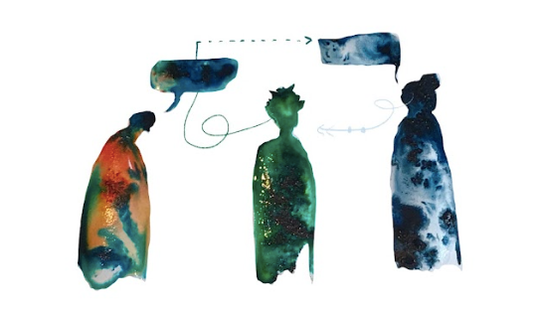
Facilitating connections
‘Recovery can take place only within the context of relationships; it cannot occur in isolation.’
Judith Lewis Herman

Slide 29
Supporting families
A key principle of trauma informed practice is ‘facilitating connections’ with family, friends and the wider community.
Families are incredibly important in facilitating coping with and recovery from trauma
In fact, what happens in the home is more important that what happens outside of the home and never is this more true when communities are affected by conflict.
Then it becomes even more essential to think not just about the support needs of the person that you are working with, but also of their wider families, what they need and how you might promote and protect connections with families.

Slide 30
Supporting families: creating a shared narrative
When individuals and whole families have been affected by trauma, it is important to focus on ways of bringing them together and fostering a sense of cohesion.
This provides opportunities for them to create a share narrative and make sense as a family of what has happened.
Any activity which encourages families to spend time together is beneficial (i.e. playing a board game, watching a TV programme, going out for a walk).
You can also strengthen relationships and improve communication in families by suggesting that they explain to each other:
- ‘I like it when you…’
- ‘You can help me by…’

Slide 31
Fostering resilience and coping in children and young people
Wherever possible try to:
Maintain a routine
Spend time together doing something enjoyable
Focus on your own wellbeing
Provide honest and accurate information (appropriate to the child’s age). Start by seeking to understand that the child or young person already knows (don’t assume you know)
Encourage children to communicate (be creative and use different techniques)

Slide 32
Supporting coping
Who is there for me?
This is a particularly useful activity for identifying and promoting access to social support.
Ask the child to make a list of seven different people who care about them
Choose a different colour thread for each person on the list
Tie all of the threads together to make a wristband
This can also provide a really useful way of ‘grounding’ children and re-connecting them with their social support network, particularly when they feel overwhelmed or distressed.

Slide 33
managing anxiety
Using ‘Worry Dolls’
The indigenous people from the Highlands in Guatemala created Worry Dolls many generations ago as a remedy for worrying.
According to legend, children tell their worries to the Worry Dolls, placing them under their pillow when they go to bed at night.
By morning the dolls have gifted them with the wisdom and knowledge to eliminate their worries.
Whilst worry dolls are often used with children, they can also work well with adults as a way of validating and recognising their fears and anxieties. By attributing a ‘worry’ or ‘fear’ to the dolls this may help the client to regain a sense of control and to externalise these feelings as well as promoting them to share them with others.

Slide 34
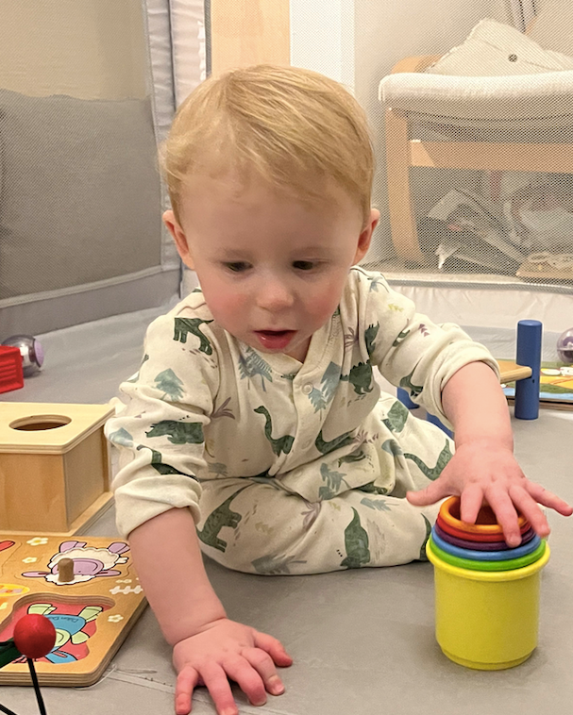
Remembering to play
Can be therapeutic in its own right
Can be either directive or non-directive
The important thing is to spend time together, doing something enjoyable.

Slide 35
Supporting parents and caregivers
Remember to:
ask questions about their support needs and give them permission to focus on their own self-care needs as well
provide reassurance (they know their child best)
provide them with access to further resources (information and support)

Slide 36
Healing-centred parenting: asking ‘what’s right with my child?’
All too often when a child or young person is affected by trauma we focus on ‘fixing’ them or making them ‘better’ and consider their behaviours as problematic.
Trauma informed parenting instead gives permission to pay attention to the things which a parent can do to promote coping and recovery within their relationship and asks them to notice ‘what’s right?’ with their child rather than simply focusing on the negative impact of the trauma.

Slide 37
Promoting coping and recovery
Safety. Routine and consistency wherever possible.
Restoring choice and control. Asking the child what they need and want (it might not be counselling/therapy) and providing them with choices wherever possible.
Supporting coping. Take the time to find out what works for them, what makes them feel ‘better’ or ‘less worse’. What do they need in order to strengthen coping?
Facilitating connections. The importance of spending time together and ensuring their access to wider family, social and community support.
Responding to identity and context. Setting aside your assumptions and seeking to understand how the child is making sense of the world around them, rather than assuming that you already know.
Building strengths. Focusing on ‘what’s right?’ with the child. Recognise how they are coping and take the time to acknowledge and share this with the child.

Slide 38
Exchanging ideas: working creatively
In your small groups share any ideas you have for working creatively.
Collate a list and when we re-form as a large group, write these into the chat
Remember to introduce yourself and provide some background about your work

Slide 39
Structuring trauma informed interventions
The SENSE model was originally developed in response to the Manchester Arena bombing in May 2017 and has since been used across a range of contexts and countries around the world.
It is comprised of 5 areas of intervention and support for those who have been affected by traumatic stress and is underpinned by the 6 key principles of trauma informed practice.
It is designed to be used by any professional or volunteer who works with people affected by traumatic stress and uses a common ‘sense’ approach to provide the following:
immediate support to cope
identification of longer-term support needs and access to information and resources
an understanding of the impact of traumatic stress to increase self-awareness and ‘active monitoring’
identification of sources of support and enabling access to this
mobilising access to social support and facilitating connections within the wider community
the early identification of the need for referral to mental health/psychology services

Slide 40
Stabilisation
Education
Normalisation
Supporting coping
Engagement

Slide 41
Stage 1: stabilisation
Addressing both practical and emotional support needs to support someone to cope
Asking basic questions such as:
What do you need?
What would be helpful at the current time?
Sometimes when people have experienced traumatic stress they may find it difficult to identify what they need.
When someone doesn’t know how to articulate their needs, offer them choices and options.
Even if someone isn’t sure what they need, they are often able to tell you what they don’t need.
Remember not just to focus on their emotional support needs, they may have a number of practical needs as well, often someone’s ability to function effectively is compromised after a traumatic event.
In the immediate aftermath of a traumatic event needs change rapidly (on a daily or even hourly basis), checking what they need on a regular basis is important.

Slide 42
stabilisation
Creating a safe, supporting and non-judgemental space to explore what someone needs
Providing support to cope with symptoms of trauma (sometimes this may need a referral for medical intervention and for trauma focused interventions)

Slide 43
Stage 2: education
Helping people to understand and recognise how they feel.

Slide 44
Stage 3: normalisation
Information and understanding will provide reassurance that how they are responding is ‘normal’

Slide 45
Education and normalisation
‘The traumatized person is often relieved simply to learn the true name of her condition. By ascertaining her diagnosis, she begins the process of mastery. No longer imprisoned in the wordlessness of the trauma, she discovers that there is a language for her experience. She discovers that she is not alone; others have suffered in similar ways. She discovers further that she is not crazy; the traumatic syndromes are normal human responses to extreme circumstances. And she discovers, finally, that she is not doomed to suffer this condition indefinitely; she can expect to recover, as others have recovered...’
Judith Lewis Herman

Slide 46
Education and normalisation
The most powerful thing you can offer is information to help someone to understand how they are feeling and the impact of traumatic stress on the mind and the body, this often restores a sense of control.
Different explanations and sources of information will resonate for different people (depending on how they are making sense of their experiences, their age and their background).
It is important to find an explanation which works for them, when you do, write it down so that they can access this when they need reassurance.
Sharing this information with their family, friends and other members of their social support network is also beneficial and often strengthens connections and opportunities to reconnect (particularly if the trauma is not a shared experience)

Slide 47
Stage 4: supporting coping (facilitating connections to social support)
Identifying and strengthening access to sources of support (this can include people, places, animals and activities - anything which supports someone to cope)
Facilitating connection or reconnection with the wider community

Slide 48
Identifying and strengthening access to sources of support
Start by asking, who or what makes you feel ‘better’ or ‘less worse’
Once you have identified sources of support, begin to map them out, think about how they help someone to cope, how accessible they are and how access can be enhanced.
The process of mapping may also include people and activities who are not so helpful and supportive and it can also be useful to identify these and think about how someone might be able to manage this contact.
Remember that creating a support map is another opportunity to be creative and can be therapeutic in its own right (encourage this!)
Often just the very process of creating a support map can be transformative and lead to change.

Slide 49
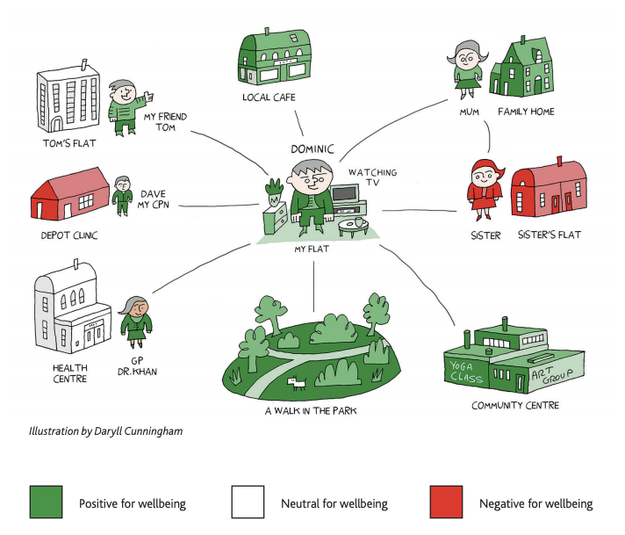
social support mapping
https://mcpin.org/wp-content/uploads/Our-briefing-paper.pdf

Slide 50
Facilitating connection or reconnection with the wider community
‘Traumatic events destroy the sustaining bonds between individual and community. Those who have survived learn that their sense of self, of worth, of humanity, depends upon a feeling of connection with others. The solidarity of a group provides the strongest protection against terror and despair, and the strongest antidote to traumatic experience. Trauma isolates; the group re-creates a sense of belonging. Trauma shames and stigmatizes; the group bears witness and affirms. Trauma degrades the victim; the group exalts her. Trauma dehumanizes the victim; the group restores her humanity.’
Judith Lewis Herman

Slide 51
An example from practice: ‘Love wins’

Slide 52
Facilitating connections
Facilitating connections with groups can include family, other social support networks and community groups (including religious and faith-based groups)
Extending support, information and education to these groups can be beneficial to strengthen their ability to provide a sense of connection at a time when it is most needed.

Slide 53
Specific interventions for families
The SENSE model can be used to provide both one to one support and also to work with entire families together.
Working with the whole family together can be useful to facilitate conversations and provide a space for the family to begin the process of creating a sense of meaning from their experiences and to focus on how to support each other.
In some circumstances it can be useful to provide support to family members separately
For example, if they require their own space to talk about the impact of the trauma, focus on their own self-care needs or wish to seek specific advice about how best they can offer support to the family member.

Slide 54
Stage 5: engagement
As the SENSE model is often used to structure time-limited support, the fifth intervention, ‘engagement’ can be used to facilitate the transition of care to longer-term support or specialist services, depending on the needs of the individual.
This intervention is all about thinking beyond what we (and those services that we provide) can offer to considering what someone might need going forward.
This can include referrals to specialist mental health and psychological support services for trauma focused treatment.

Slide 55
Engagement – thinking beyond the trauma
However, it should also involve referring to or encouraging engagement with any services or organisations that support someone to cope (remembering that people ‘cope’ in different ways).
For example:
Sports clubs
Yoga and relaxation groups
Arts and craft activities
Dog walking groups
Using the knowledge generated during the ‘supporting coping’ phase, explore options for accessing those activities which someone has identified will support them to cope. This could involve contacting organisations to find out more about what they can offer to make the information and the prospect of engagement more accessible.

Slide 56
Engagement: creating an individualised plan of support
To promote engagement with other services it can be beneficial to create an individualised support plan detailing the services and activities which you have found. This should also include information about how best they can be accessed, any restrictions or waiting times and what they might expect from the organisation.
Writing down this information in the form of a letter can often help to personalise it and also to reiterate that when and if someone wishes to engage with these options should be their own choice, when they feel ready to do so.
In creating an individualised plan of support it is also important to remember that you are working in collaboration with someone, you should encourage them to take an active part in identifying other services or organisations that they would like to work/be involved with. Don’t assume that you know what they need or want, check this first, someone will be more likely to engage and remain engage with activities if it is actually what they need and want to do, only they can decide this.

Slide 57
A trauma informed approach to structuring support
‘The first principle of recovery is empowerment of the survivor. She must be the author and arbiter of her own recovery. Others may offer advice, support, assistance, affection, and care, but not cure. Many benevolent and well-intentioned attempts to assist the survivor flounder because this basic principle of empowerment is not observed. No intervention that takes power away from the survivor can possibly foster her recovery, no matter how much it appears to be in her immediate best interest.’
Judith Lewis Herman

Slide 58
Using the sense model in practice
The SENSE model can be applied in a number of different ways depending on the needs of the organisation.
For example it can be used to:
Structure trauma informed conversations
Provide a series of trauma informed sessional interventions (SENSE 8+2)
Offer crisis support across 3-4 interventions
Create additional support pathways for family members (SENSE 3)

Slide 59
Planning sessional interventions
It can be helpful to create an agenda for each session together with the person you are supporting.
Ideally, each session should also end with setting an agenda for the next session but it is useful to check at the beginning that it is still relevant (remember that things may have changed since the last session)
You could also ask:
What else would it be helpful to focus on today?
What do you need from today’s session?
Remember to introduce choices and restore a sense of control wherever you can.
A trauma informed approach is about meeting someone where they are at and supporting them to cope.
Try to maintain a flexible approach which allows the focus of the session to change in response to someone’s needs. It is their space and about what they need to do, rather than what you need to do.

Slide 60
Trauma informed approaches to measuring impact
Often measuring impact involves a pre-determined set of goals or outcomes, often agreed as part of the commissioning or funding arrangements.
Instead, a trauma informed approach to measuring impact asks that those accessing our support services identify their own ‘goal’ or ‘motivation’ which they wish to achieve.
Once this has been identified, they can be asked to rate themselves at various points throughout their engagement with the service using the below statements:
‘I have not yet achieved this’
‘I am working towards achieving this’
‘I have achieved this!’
This allows for a strength-based outcome measure which is designed to recognise and celebrate resilience and coping. It also provides a standardised measure of progress and impact across the whole service and a useful way of checking that the support is meeting the needs of beneficiaries, as identified by themselves.

Slide 61
Barriers to developing Trauma informed approaches to practice
In your small groups consider what (if any) barriers you might face in developing a trauma informed approach to practice
Discuss and share ideas about how to overcome these
Identify what else you might need, share this with the wider group in the chat

Slide 62
Managing exits
It can be challenging to create an end-point, particularly if you have been working with someone for a long time or they still have unmet needs which you are not able to address as part of your work (for example, if they require a referral to mental health services).
If the support that you are able to offer is time-limited, it is important to explain this from the outset and to work in partnership to plan the sessions. This may also need you to reiterate the limitations of the number of sessions as part of this planning process to manage expectations and to provide the space to have conversations about the support coming to an end.
The personalised support plan of the SENSE model can often be useful in helping to structure endings.
Marking the ending with a card can also be good opportunity to reflect on the progress that someone has made, to remind them of their strength and resilience and to acknowledge that it has been a privilege to join them on part of their journey.

Slide 63
Understanding and responding to vicarious trauma: it will never be enough
‘It is very tempting to take the side of the perpetrator. All the perpetrator asks is that the bystander do nothing. He appeals to the universal desire to see, hear, and speak no evil. The victim, on the contrary, asks the bystander to share the burden of pain. The victim demands action, engagement, and remembering.’
Judith Lewis Herman

Slide 64
Understanding vicarious trauma
Vicarious trauma is a term used to describe the process of being exposed to trauma, vicariously (not experiencing it directly) but instead:
witnessing the event in real time
witnessing after the event (i.e. listening to someone share their experiences, reading case notes or statements of impact, or reading news stories)
being a first responder witnessing the aftermath
being in the physical presence of someone who is experiencing post-traumatic stress
There are strong links between empathy and experiences of vicarious trauma, it is often referred to as a ‘double-edged sword’ in extending care for others, you may do so at a cost to yourself.

Slide 65
The processes of vicarious trauma
A change in worldview
Over time someone may feel as though their outlook on the world, their feelings of safety and even their personality seems to have changed.
Professionally a change in our view of the world can lead to:
A feeling of disconnection from our values and motivation to do the work
cynicism, lack of sympathy or lack of engagement with those we care for/support
cynicism towards management and/or systems
blurring of boundaries (trying to do more than is in your role to help)
feeling like a failure or an imposter
guilt (bystander guilt)

Slide 66
The effects of vicarious trauma
When someone experiences vicarious trauma it can lead to transformation in 5 key areas in their own lives:
A sense of safety in the world
The ability to trust
Self-esteem
Loss of a sense of control
Compromises intimacy and the ability to form and sustain relationships with others

Slide 67
Reducing the potential for vicarious trauma
Developing self-awareness (know your glass jar, how full it is and what you need to empty it out)
Access to peer and managerial support
Opportunities to engage in reflective practice
Access to training and continuing professional development
Work-life balance
Focusing on what you can do rather than on what you can’t
Reconnect with and be realistic about what you can achieve

Slide 68
vicarious post traumatic growth
Positive gains in self-perception
Gains in interpersonal relationships
New-found appreciation for themselves, others or even the entire world
(Hyatt-Burkhatt, 2014)

Slide 69
Therapeutic resources

Slide 70
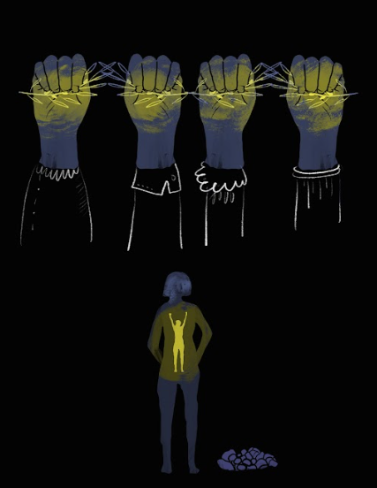
Affirmations

Slide 71
Making a commitment to a trauma informed approach
In bearing witness to distress we are privileged to observe moments of great strength and courage. Such moments inspire not only our work but our own lives. We see the parts of humanity that others do not and whilst much of this landscape can be filled with darkness, at times there is also the most incredible light.

Slide 72
achieved

Slide 73
Further training: Gold Level workshop: Committed to Trauma Informed Practice

Slide 74
+44 7912 763247

