Slide 1
Nicola Lester
BOOKS FOR RECONNECTION– SESSION 1
Disconnection:
Ways of knowing, seeing and being in the darkness
consultancy@nicolalester.co.uk

Slide 2
introduction
SESSION 1: DISCONNECTION - WAYS OF KNOWING, SEEING AND BEING IN THE DARKNESS
Selected text: Brené Brown, ‘Atlas of the heart’
SESSION 2: FINDING RECONNECTION AFTER TRAUMATIC BEREAVEMENT.
Selected text: Megan Devine, ‘It’s ok that you’re not ok’
SESSION 3: RECONNECTING SYSTEMS
Selected text: Brené Brown, ‘Dare to lead’
SESSION 4: TENDING TO AND MENDING OUR BROKEN HEARTS
Selected text: Emily and Amelia Nagoski, ‘Burnout’
SESSION 5: LEARNING TO RISE IN THE DARKNESS
Selected text: Brené Brown, ‘Rising strong’
SESSION 6: BEYOND RECONNECTION
Selected text: Tarana Burke and Brené Brown, ‘You are your best thing’

Slide 3
Books for reconnection
Inspiration
New ways of connecting (to self and others)
Solidarity and humanity
Insight and understanding
Learning (creating book clubs)
Support (bibliotherapy)

Slide 4
Seeing and being in the darkness
From disconnection to reconnection: therapeutic skills for practice
Introduction to Brené Brown’s ‘Atlas of the Heart’
Defining disconnection, connection and reconnection
The words that we choose, matter.
Seeing in the darkness: defining the emotions of disconnection

Slide 5
‘atlas of the heart’
Map of human emotions: ‘the places we go when…’
Definitions of emotions (‘knowing’ enables us to work with them)
Related, but different
Feelings are for feeling (permission and acceptance)

Slide 6
Changing practice
Understanding ‘anguish’ in bereavement work
The difference between ‘shame’ and ‘blame’, ‘belonging’ and ‘connection’
Knowing that ‘anger’ can be constructive or destructive - restoring control
A framework for feelings to be explored, understood and accepted (going to these places and looking at the view, rather than wishing we were not there).

Slide 7
Defining disconnection
Judith Jordan (Relational-Cultural Theorist) sees disconnection as:
‘…normative and inevitable in relationships; they occur when one person misunderstands, invalidates, excludes, humiliates or injures the other person in some way.
Acute disconnections occur frequently in all relationships. If they can be addressed and reworked, they are not problematic, in fact, they becomes places of enormous growth’
p. 171 Atlas of the Heart
Remember how ruptures occur in all relationships but that real magic can happen in the repair.

Slide 8
Defining disconnection
However:
‘When an injured person, particularly one who has less power, can represent (their) experience of disconnection or pain to the more powerful person and be responded to, with interest or concern, the less powerful, hurt person has the sense of ‘mattering’…this strengthens connection…’
p. 171 Atlas of the Heart
Reconnection starts with ‘noticing’ (curiosity and care) that disconnection (the pain and the hurt which has been both caused and endured) has occurred.

Slide 9
Defining connection
‘The energy that exists between people when they feel seen, heard, and valued; when they can give and receive without judgement; and when they derive sustenance and strength from the relationship’.
Brené Brown, Atlas of the Heart (2021) p.169

Slide 10
Defining REconnection
Reconnection needs us to go beyond connection to first understand the experience of disconnection and isolation. It asks that we start where someone is, rather than where we think they are or should be or where we want them to be.
When someone becomes separated we rarely find them where they were left, instead we often have to travel further to retrieve them and to accept that the way back may take longer than we imagined.

Slide 11
Kindness
Kindness is our superpower. When our intentions are grounded in kindness our capacity for connection is limitless. Kindness knows no bounds and can transcend our differences in class, race, gender, ethnicity, political views and social circumstances.
Defined by the qualities of:
Friendliness
Generosity
Thoughtfulness

Slide 12
“Nothing beats kindness”
said the horse.
“It sits quietly beyond all things”.
Charlie Mackesy (2014) The boy, the mole, the fox and the horse

Slide 13
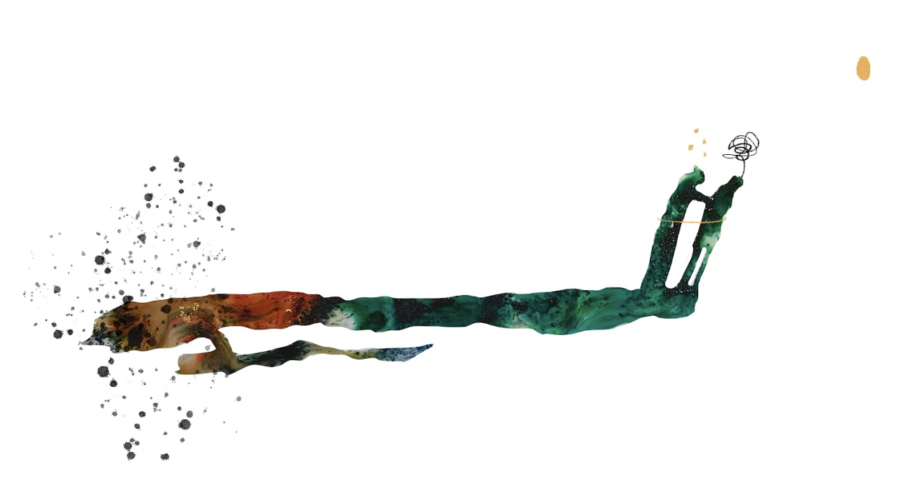
Compassion
Defined literally as ‘to suffer with’.
Compassion requires us to acknowledge and pay attention to the pain and anguish that someone may be experiencing and to respond and take action, even if the action is simply to sit and remain present so that they are not alone.
Compassion differs from other terms such as sympathy, pity, concern, condolence, sensitivity, tenderness, commiseration, even empathy in its demand for action.

Slide 14
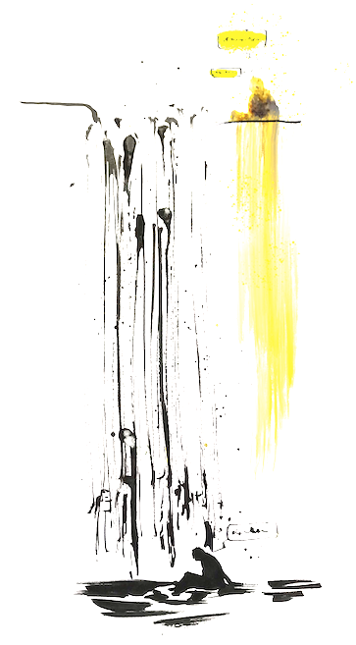
Empathy
Empathy is a tool of compassion, an emotional skill which enables us to understand what someone is experiencing and to reflect back that understanding.
As with compassion, empathy cannot occur at a distance and is only true empathy when we make a commitment to be present and bear witness through listening and hearing, seeing and seeking to understand, curiosity and humility.

Slide 15
MYTHS OF EMPATHY
‘We need to dispel the myth that empathy is ‘walking in someone else’s shoes.’ Rather than walking in your shoes, I need to learn to listen to the story you tell about what it’s like in your shoes and believe you even when it doesn’t match my experiences’.
Brené Brown (2021) p.122 ‘Atlas of the Heart’

Slide 16
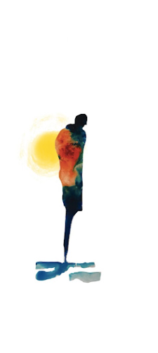
Withholding judgement and extending acceptance
Acceptance in place of judgement allows us to focus on what is, rather than what is not and perhaps most importantly to ask what’s ‘right’ with someone instead.
Accepting how someone is and who they are is to ensure that they are seen, heard and valued, no matter what.

Slide 17
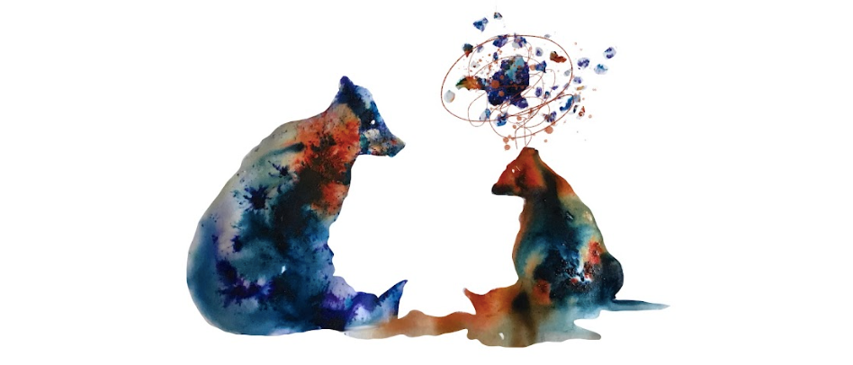
Story stewardship
In trauma informed practice we do not need to know ‘what’s happened’ to someone. However, if someone chooses to share their experience we must know how to ‘steward’ their story, after all there is no greater privilege than being trusted with this.
Key skills in story stewardship include:
Listening and taking the time to ‘hear’ what someone is sharing with us
Being curious, asking questions and seeking to understand (checking)
Affirming and validating
Believing (in trauma informed practice, it is not your intention to verify). The only truth is that which belongs to the person telling their story.

Slide 18
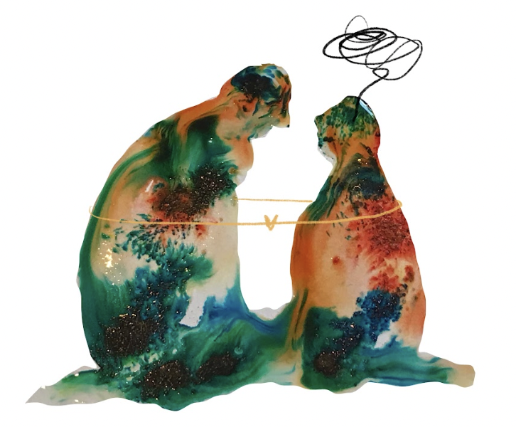
Understanding, curiosity and humility
Empathy demands understanding which in turn requires us to be curious, ask questions, seek information and above all, to practice humility.
To accept we may not know, to challenge our judgements and to correct our assumptions.
In trauma informed practice there is no wounded and no healer.
We sit beside someone in their darkness as their equal, no matter how experienced we are, in this place, we are learning how to be with them and what they might need.

Slide 19
Reconnection needs our ability to work creatively. We must practice beyond the limits which so often constrain our work and explore new ideas. We must find new tools, new approaches and learn from each other. We must stay open, curious and hopeful.

Slide 20
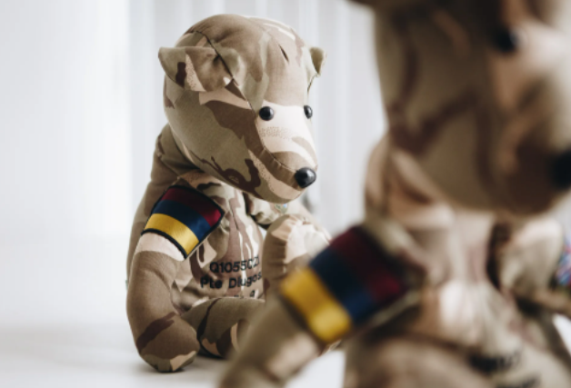

Slide 21
Commitment and courage
‘Vulnerability is not weakness; it’s our greatest measure of courage.’
‘There is no courage without vulnerability’
Brené Brown (2021) p.14 ‘Atlas of the Heart’

Slide 22
“What is the bravest thing you’ve ever said?”.
“Help” said the horse.
Charlie Mackesy (2014) The boy, the mole, the fox and the horse

Slide 23
In trauma informed practice there can be no formula for reconnection, only a collection of the most intrinsic qualities of what it means to be human. The path from disconnection to reconnection will look different for everyone and no two journeys will ever be the same. We are not the guide who knows the way but the companion who joins them to work it out. This needs our kindness and warmth, compassion and empathy, our commitment and creativity, courage and humility. Above all though, it requires our acceptance of both ourselves and who we find there.

Slide 24
Near Enemies of a trauma informed approach
Behaviours and actions which masquerade as forms of connection but in fact ‘undermine’ and create disconnection instead. For example:
Pity and sympathy
Often delivered at a safe distance creating isolation rather than unity. According to Atlas of the Heart, ‘pity’ in particular comprises of 4 elements which disconnect rather than reconnect (p.120):
The suffering person is inferior.
A passive and self-focused reaction that does not include providing help.
A desire to maintain emotional distance.
Avoidance of sharing in the other person’s suffering.
Rescuing, fixing and problem-solving
Comparison and identification
Pushing gratitude

Slide 25
The language that we use matters, we can infuse it with kindness and meaning, creating an effect which lasts beyond our work. We can invite collaboration and exploration and test out new descriptors to give voice to thoughts and emotions which have been hidden and suppressed. We can name and claim our stories by paying attention and seeking feedback.

Slide 26
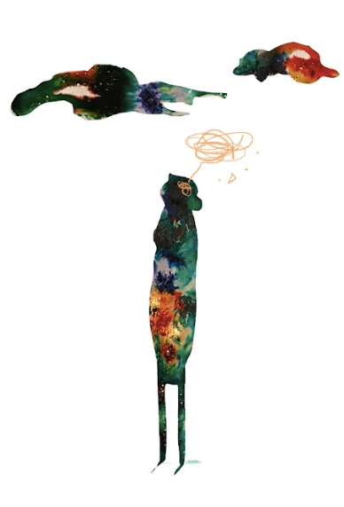
Not knowing and saying the ‘wrong’ thing
The ’right’ approach will take time to cultivate but kindness and compassion will catch us if we misstep and strengthen the relationship instead.

Slide 27
The words that we choose matter (being curious and taking care)
‘Resilient’
‘Emotional’
‘Sensitive’

Slide 28
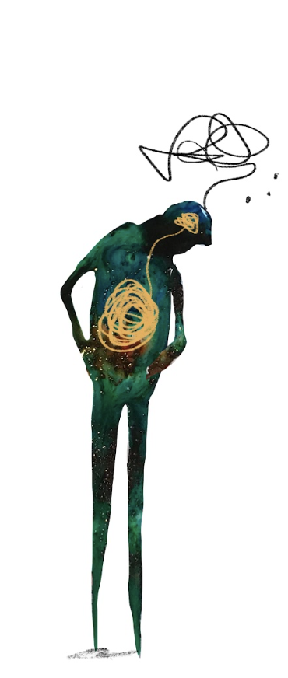
The difference between a ‘trait and a ‘state’
A trait is part of an individual’s personality. A long-term characteristic which shows up in how they think, feel and behave.

Slide 29
Practicing ‘reconnection’
In groups of 3, take it in turns to be in the following roles:
- Supporter
- Beneficiary (the person receiving the support
- Observer
The person receiving the support should identify an issue which they would like to talk about (something which is stressful but manageable 4/5 out of 10).
The support should initiate a 5 minute conversation to explore their experiences, how they doing and what they might need.
After 5 minutes, come together as a group of three to reflect and share your observations and feedback.
Remember that there is no right or wrong approach, however, it would be good to explore the experience of both giving and receiving support. Did the recipient feel seen, heard and valued? What helped? What was observed to have happened. Try to offer each other specific examples in the feedback.
A word of advice: Don’t overthink it, you know how to be human.

Slide 30
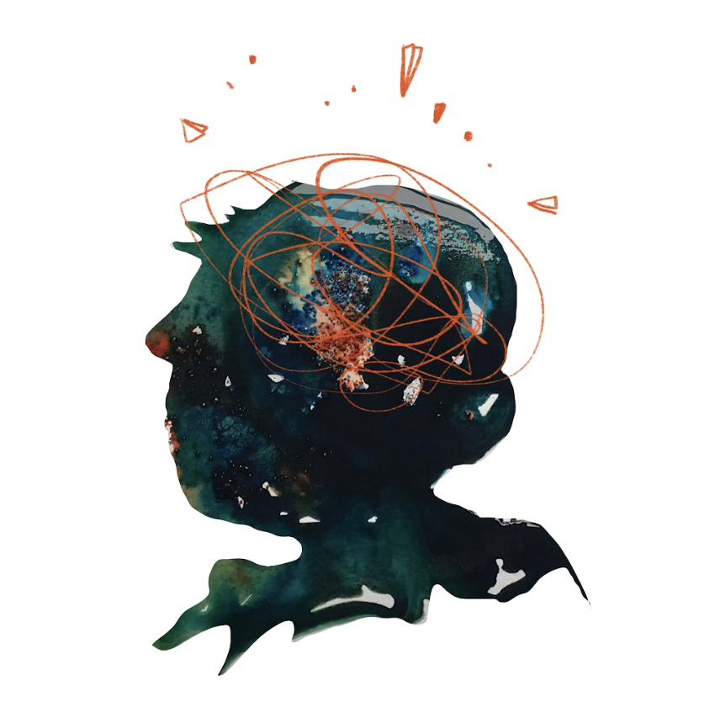
Mapping the darkness
Anguish
Hopelessness and despair
Sadness
Grief
Shame and guilt

Slide 31
anguish
Anguish is an almost unbearable and traumatic swirl of shock, incredulity, grief and powerlessness. Shock and incredulity can take our breath away, and grief and powerlessness often come for our hearts and our minds.
We are unable to change, reverse, or negotiate what has happened. And even in those situations where we can temporarily reroute anguish with to-do lists and tasks, it finds its way back in.
Atlas of the Heart, p.91

Slide 32
Hopelessness and despair
Hopelessness arises out of a combination of negative life events and negative thought patterns, particularly self-blame and the perceived inability to change our circumstances.
Atlas of the Heart p.101
Despair is a sense of hopelessness about a person’s entire life and future. When extreme hopelessness seeps into all corners of our lives and combines with extreme sadness, we feel despair.
Atlas of the Heart p.102

Slide 33
Working with Hopelessness and despair: cultivating hope
Hope is a function of struggle - we develop hope not during the easy or comfortable times but through adversity and discomfort.
Atlas of the Heart p.100
Hope can be learned in childhood and adolescence and developed through boundaries, consistency and support.
Asking ‘what’s right?’ can draw our attention to the ‘hope’ that can emerge from struggle and adversity.

Slide 34
Working with Hopelessness and despair: cultivating hope
We need hope like we need air.
C.R. Snyder: ‘Trilogy of goals, pathways, and agency’
Hope can be experienced when:
We have the ability to set realistic goals
We can work out how to achieve these goals, be flexible and set alternatives
We have agency (self-belief)
Atlas of the Heart p.97

Slide 35
Working with Hopelessness and dEspair: cultivating resilience
Martin Seligman’s research on resilience: The 3 Ps
Personalisation (self-blame and self-criticism). The importance of noticing context and practicing self-compassion and acceptance.
Permanence (there is no light versus there will be light again)
Pervasiveness (failure to notice any chinks in the darkness which let in the light).
Atlas of the Heart p.103-104

Slide 36
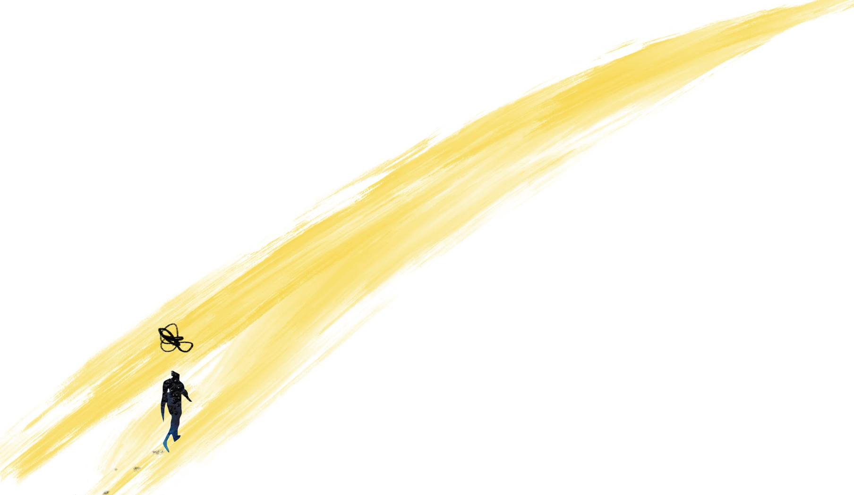
cultivating hope and resilience
Remember that in the darkness, we need only create the briefest flickers of light. Together these tiny flickers of light will illuminate the path from disconnection to reconnection.

Slide 37
sadness
Sadness is important and we need it…To be human is to know sadness. Owning our sadness is courageous and a necessary step in finding out way back to ourselves and each other.
Atlas of the Heart p. 106

Slide 38
sadness
Sadness and depression are not the same thing.
Sadness and grief are not the same thing.
There are positive aspects to sadness (such as the impetus to evaluate life, seek support and connection and make changes)
There is a reason that we love sad movies (We like to be moved. We like to feel connected to what it means to be human.
Atlas of the Heart p.106-108

Slide 39
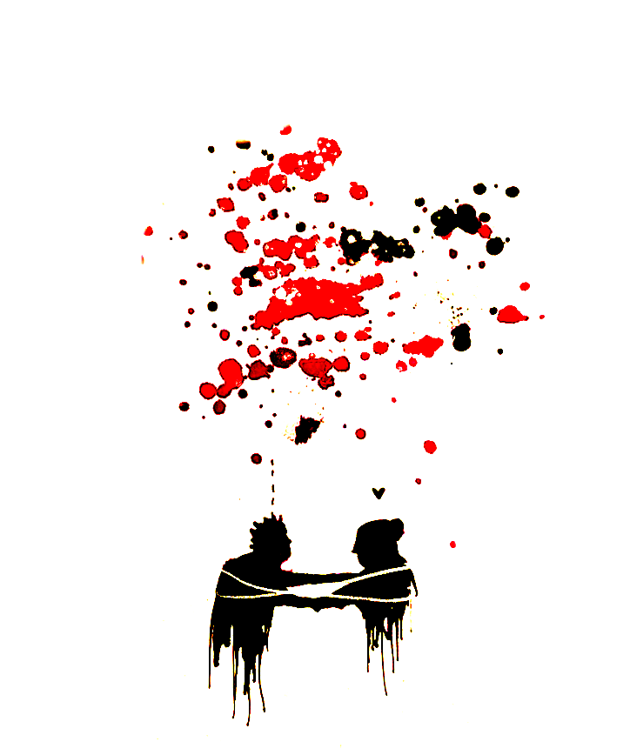
Working with sadness
Bearing witness
Accepting and allowing
Noticing what it is telling us
To bear witness to grief is also to bear witness to the most incredible love

Slide 40
grief
Grief does not obey your plans, or your wishes. Grief will do whatever it wants to you, whenever it wants to. In that regard, Grief has a lot in common with Love.
Elizabeth Gilbert
Atlas of the Heart p.110

Slide 41
grief
A process which includes many emotions
Not a linear process (nor is it predictable)
3 foundational elements
Loss (different types of loss, not always tangible)
Longing (not conscious wanting; involuntary yearning for wholeness)
Feeling lost (requires us to reorient every part of our physical, emotional, and social worlds)
Atlas of the Heart p.110-111

Slide 42
grief
The more difficult it is for us to articulate our experiences of loss, longing and feeling lost to the people around us, the more disconnected and alone we feel. Talking about grief is difficult in a world that wants us to ‘get over it’ or a community which is quick to pathologize grief.
Atlas of the Heart p.111

Slide 43
grief
Every experience of grief is different and unique. What everyone has in common is the need for their grief to be witnessed.
Most people who struggle with complicated loss feel a great press ‘to tell the story’, to find someone willing to hear what others cannot, and who can join them in making sense of the death.
The need for connection and storytelling.
Atlas of the Heart p.111-112

Slide 44
Different types of grief
Different types of grief:
Acute grief. Grief dominates our lives.
Integrated grief. Grief finds a place in our lives, but it is not our whole lives.
Complicated grief. Something interferes with adaptation and integration.
Disenfranchised grief. The experience of loss is not valued or understood as a ‘loss’ by others.
Atlas of the Heart p.113

Slide 45
Shame and guilt
Shame. I am bad. The focus is on self, not behaviour. The result is feeling flawed and unworthy of love, belonging and connection. Shame is not a driver of positive change.
Guilt. I did something bad. The focus is on behaviour. Guilt is the discomfort we feel when we evaluate what we’ve done or failed to do against our values. It can drive positive change and behaviour.
Atlas of the Heart p.134
It is important to make a clear distinction between the two, there can be something powerful about the shift from shame to guilt in our work.

Slide 46
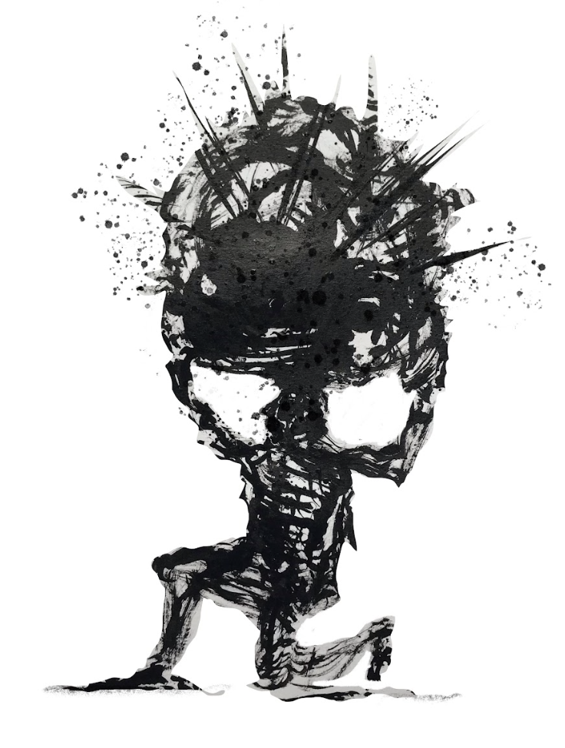
Shame
Shame is universal.
We’re all afraid to talk about it.
The less we talk about it, the more control it has over us.
Shame hates being spoken.

Slide 47
Shame
Shame is the fear of disconnection. It is the intensely painful feeling or experience of believing that we are flawed and therefore unworthy of love, belonging and connection.
Shame thrives on secrecy, silence and judgement.
Atlas of the Heart p.137

Slide 48
Shame
The antidote to shame is empathy and self-compassion. Shame is a social emotion, sharing our experiences of shame can lead to experiences of empathy. But first self-compassion is needed so that we might feel safe to share these experiences (remember that shame thrives on secrecy and not being spoken).
Atlas of the Heart p.137

Slide 49
Self-compassion
Kristin Neff identifies elements of self-compassion:
Self-kindness rather than self-judgement
Common humanity rather than isolation
Mindfulness rather than over-identification
Atlas of the Heart p.138

Slide 50
Shame resilience
Four elements:
Recognising shame and understanding its triggers
Practicing critical-awareness
Reaching out
Speaking shame
Atlas of the Heart p.139

Slide 51
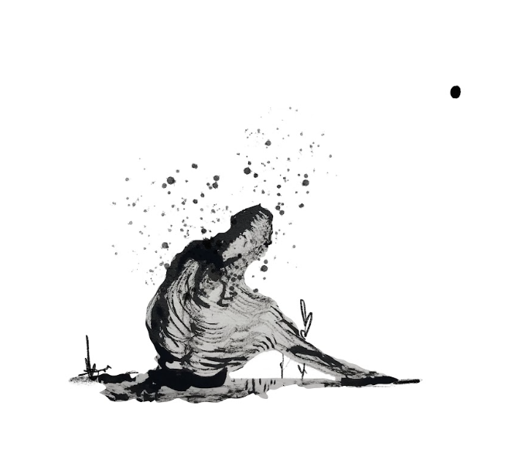
Other emotions of disconnection
Betrayal (trust)
Heartbreak (love)
Disappointment (hopes and dreams)
Anger (control)

Slide 52
from disconnection to reconnection
Noticing and naming
Seeking to understand
Bearing witness
Offering empathy
Practicing compassion
Withholding judgement
Creating acceptance

Slide 53
