Slide 1
Nicola Lester
Trauma Aware
BRONZE LEVEL
consultancy@nicolalester.co.uk

Slide 2
content
Understanding traumatic stress and complex trauma
Understanding trauma and loss
Introduction to trauma informed practice
Trauma informed approaches to humanitarian crisis: understanding context
Supporting coping
Self-care
Questions and consultation

Slide 3
Understanding traumatic stress
Traumatic stress is a specific type of stress that reflects exposure to emotionally distressing events.
Traumatic stress is actually a normal response to something which has happened which is not normal.

Slide 4
Understanding traumatic stress
Traumatic stress can be caused by:
experiences or situations that are emotionally painful and distressing, and that overwhelm a person’s ability to cope, leaving them powerless.
circumstances that are outside the realm of normal human experience and shatter our assumptions about the world around us.

Slide 5
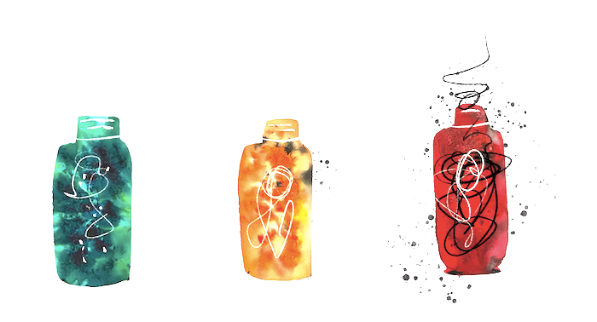
The ‘glass jar’ theory of traumatic stress

Slide 6
Different types of stress
Positive stress
(green)
Normal and essential part of life
Brief increases in heart rate and blood pressure
Examples: working to a tight deadline, or studying for an exam

Slide 7
Different types of stress
Tolerable stress
(amber)
The body’s alert system is activated to a greater degree
Activation is time-limited and buffered by access to support
Examples: death of a loved one, natural disaster, divorce

Slide 8
Different types of stress
Toxic stress
(red)
Occurs with strong, frequent and prolonged adversity
Limited access to support
Examples: ongoing conflict, situations of ongoing uncertainty and instability
*Adapted from the Rhode Island Department of Health

Slide 9
Theories of Trauma: ‘shattered assumptions’

Slide 10
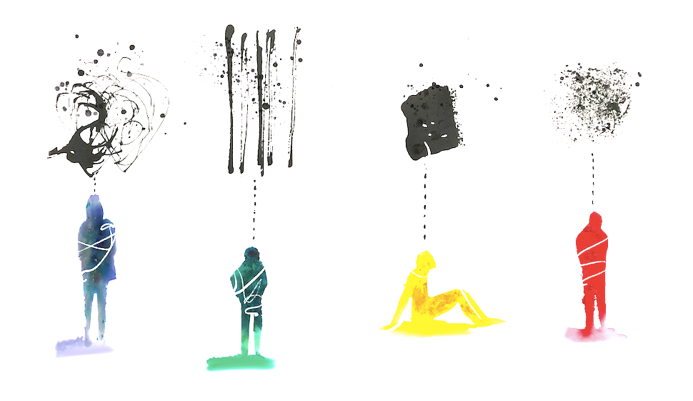
The impact of trauma
The way we think, the way we learn, the way we remember things, the way we feel about ourselves, the way we feel about other people, and the way we make sense of the world are all profoundly altered by traumatic experience.
/

Slide 11
The impact of trauma
intrusive thoughts or flashbacks
nightmares
having problems sleeping or staying asleep
not being able to feel emotions (feeling numb and detached)
not feeling connected to other people (isolating ourselves from others)
not enjoying the activities that we previously did
staying away from situations that remind us of the trauma
feeling anxious, on edge, being startled easily and always on the look-out for threats
feeling irritable and angry
difficulties managing emotions
/

Slide 12
The impact of trauma
After a traumatic experience, the human system of self-preservation seems to go onto permanent alert, as if the danger might return at any moment.
Judith Lewis Herman/

Slide 13
The impact of traumatic stress
When someone has experienced trauma they may:
Be easily overwhelmed and feel frightened and out of control
Find it difficult to understand, retain and process information
Find it difficult to focus and concentrate
Find it difficult to engage with support that is provided
/

Slide 14
Accounting for The impact of traumatic stress
Present information in different ways to make it more manageable (for example, writing it down, sending it as a text/WhatsApp message)
Provide more time and check understanding more regularly
Be proactive in how you engage someone (remind them of appointments, check in with them if they don’t attend)
Find creative ways of engaging and communicating with someone /

Slide 15
Understanding the impact of complex trauma
The UK Trauma Council defines complex trauma as traumatic experiences involving multiple events with interpersonal threats during childhood or adolescence.
Such events may include abuse, neglect, interpersonal violence, community violence, racism, discrimination and war.
(UK Trauma Council, 2022)
/

Slide 16
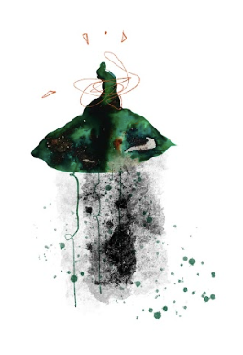
Understanding the impact of complex trauma
A term used to describe childhood trauma such as chronic abuse, neglect, separation or adverse experiences which happen within a child’s significant relationships.
Although complex trauma involves prolonged or repeated exposure during critical developmental windows (which occur during early childhood) and transitions (such as adolescence), understanding how it affects development can be useful to help us to understand how this in turn shapes the behaviour of adults.
This understanding allows us to adopt a trauma informed approach to engagement and support, focusing not on what’s wrong with someone, but seeking to understand how someone’s experiences may affect them and accounting for this in our work. /

Slide 17
Understanding complex trauma
When a child has been exposed to trauma over a long period, they become stuck in their ‘primitive brain’ which is responsible for our survival systems - flight, fight or freeze.
Very little information is passed to other parts of the brain.
Very little opportunity for the development of other skills such as:
processing
retaining new information
reasoning
empathy
being able to accurately interpret the behaviour of others/

Slide 18
Understanding complex trauma: brain development
To understand complex trauma it is useful to think about how the brain develops.
The brainstem or ‘primitive’ brain develops first - responsible for sensory, motor and survival skills.
The ‘limbic’ brain develops next - responsible for attachment and emotional development.
Finally, the ‘cortical’ brain develops - responsible for thinking, learning, language and inhibition.
/

Slide 19
complex trauma
When a young child is exposed to trauma very early in their lives, they may not have the language skills to make sense of their experiences.
Their memories are ‘sensory memories’ - the body has stored these memories in their sensory systems.
Traumatised children are stuck in ‘fear mode’ as they grow up. Their hyper-vigilance and sensitivity to danger is so strong it reduces their ability to filter out other sensory experiences (e.g. noises, sights, sounds and smells).
Instead their sensory system becomes overloaded and overwhelmed causing them to find it difficult to regulate or contain their emotions.

Slide 20
complex trauma
Children may also dissociate which:
Is a survival mechanism.
Can be useful when children are exposed to high levels of trauma and danger.
Helps children (and adults) to cope by enabling them to detach or disconnect between the mind and the body.
However, even when not in danger, children may continue to dissociate and it can seem as though they are lacking in focus or not listening.

Slide 21
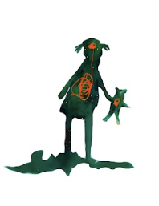
complex trauma
Patterns of attachment:
Children who are exposed to trauma learn different strategies of attachment to prevent harm and danger or to keep a parent/caregiver as close as possible.
These strategies are known as either ‘insecure avoidant attachment’ or ‘insecure preoccupied attachment’

Slide 22
complex trauma
Insecure avoidant attachment:
Children learn very early on that showing their feelings triggers danger or causes the withdrawal of a parent/caregiver.
They learn to hide their emotions and pretend that everything is okay.
Inside they may feel vulnerable and frightened but they present themselves to the world as bright and confident and fine.
However, these children may be triggered later in childhood or as adults by something stressful as their ‘glass jar’ becomes too full and overflows.

Slide 23
complex trauma
Insecure pre-occupied attachment:
Instead these children learn the importance of showing their feelings in order to get noticed and attract attention.
They learn to exaggerate their behaviour and can appear angry, hostile, aggressive and disruptive, whilst on the inside they are actually feeling frightened, vulnerable and anxious.

Slide 24
complex trauma
Emotional regulation:
Emotional regulation is a skill learnt in early childhood.
When children are exposed to trauma, the part of the brain responsible for emotional regulation does not develop fully.
Instead it gets stuck in the ‘toddler’ phase
We often think of these behaviours as ‘attention seeking’.
Instead we should think of them as ‘attachment seeking’.
Difficulties regulating emotions can lead to unhealthy coping strategies (e.g. self-harm, drugs and alcohol).

Slide 25
complex trauma
Behavioural regulation:
Everyone has a ‘window of tolerance’ - when we are in our window of tolerance we can think and learn.
When a child has been exposed to trauma their ‘window of tolerance’ is much narrower. This means that when there are increased demands made of them, even small ones, this can cause them to move quickly outside of this window of tolerance.
This may trigger them to become over-aroused (flight and fight response) or under-aroused (when they shut down completely).

Slide 26
Complex trauma
Cognition:
Children who have experienced trauma struggle with under-developed cognitive skills which affect their ability to:
plan for the future
organise themselves
learn from their mistakes
They are stuck in the ‘limbic’ part of the brain and use all of their energy to stay safe and work out if they can trust the people around them. This then limits their ability to develop other skills.

Slide 27
complex trauma
Cognition:
Self-concept and identity development:
Children who have been exposed to trauma, particularly over a long period of time, are often left with a deep sense of being unlovable, bad and unwanted.
This starts to be how they see themselves, no matter how much reassurance is given by those around them.
This may create a vulnerability to exploitation and abuse in relationships.

Slide 28
Understanding complex trauma
‘..repeated trauma in childhood forms and deforms the personality. The child trapped in an abusive environment is faced with formidable tasks of adaptation. She must find a way to preserve a sense of trust in people who are untrustworthy, safety in a situation that is unsafe, control in a situation that is terrifyingly unpredictable, power in a situation of helplessness. Unable to care for or protect herself, she must compensate for the failures of adult care and protection with the only means at her disposal, an immature system of psychological defenses.’
Judith Lewis Herman
/

Slide 29
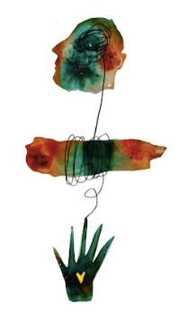
Working with complex trauma
Things to remember:
Behaviours that may be labelled by ourselves and others as ‘attention seeking’ are in fact ‘attachment seeking’, someone is trying to tell you something really important about how they feel.
'Beneath every behaviour there is a feeling. And beneath every feeling there is a need.’
Julie Budge, My Sister’s House: From Kitchen Table to Women’s Centre
A trauma informed approach is not about asking ‘what’s wrong with someone?’, nor is it simply about understanding ‘what’s happened to them?’, it is more than this; it is asking ‘what’s right with someone?’.
The importance of focusing on how someone is coping rather than how they are not (recognise and acknowledge their resilience and strength/

Slide 30
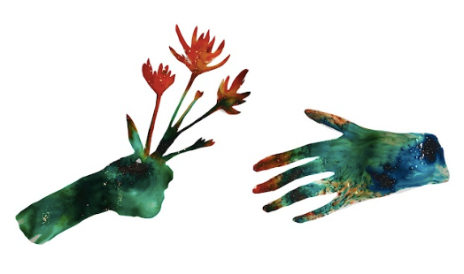
Working with complex trauma: a ‘human’ response
‘Repeatedly in the testimony of survivors there comes a moment when a sense of connection is restored by another person’s unaffected display of generosity. Something in herself that the victim believes to be irretrievably destroyed---faith, decency, courage---is reawakened by an example of common altruism. Mirrored in the actions of others, the survivor recognizes and reclaims a lost part of herself. At that moment, the survivor begins to rejoin the human commonality...’
Judith Lewis Herman/

Slide 31
Trauma informed approaches to working with ‘harmful’ coping strategies
Harmful strategies can keep people alive and safe.
What looks to us as though someone is not coping is in fact the opposite; they are coping in the best way they know how.
To not acknowledge this truth creates stigma, shame and secrecy which only grows the more we seek to stop or change their behaviour.
So, instead, we start by understanding how this behaviour works for someone.
We set aside our own fears and judgements to create a space in which the behaviour can be disclosed, explored and understood.
It is only then that we might hope to suggest alternative ways of coping.

Slide 32
Understanding traumatic bereavement
When bereavements occur under external traumatic circumstances they can lead to symptoms of post traumatic stress.
Those who are bereaved are faced with the dual task of mourning the loss and coping with the trauma that accompanied the loss
Trauma and grief are interwoven - grief symptoms are overlaid with trauma symptoms.
/

Slide 33
Understanding traumatic bereavement
When a death occurs under external traumatic circumstances it increases the likelihood of ‘complicated grief’:
Risk factors for ‘complicated grief’ include:
Circumstances of the death
Context of the death
Consequences of the death
Sudden, unexpected, random
/

Slide 34
Additional challenges: attitudes to death
Remains a ‘taboo’ subject, often not discussed
Fraught with assumptions about ‘how’ people should be, ‘what’ they should be thinking and feeling and for ‘how long’ they should be grieving
There is a need to consider and account for different cultural understandings and assumptions
Evokes a sense of uncertainty about how to engage with those who are grieving (fear of saying or doing the wrong thing and making it worse)
/

Slide 35
Understanding complicated grief
“Grief transforms. Grief changes you as few other experiences can…it strikes deep, unsettling, breaking apart, shattering what was once stable and secure”
(Del Rosario, 2004)
/

Slide 36
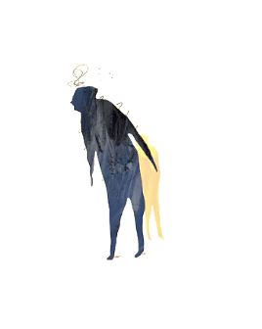
‘Growing around grief’
In the beginning there is only grief, it is all consuming, crowding out any capacity to experience hope, happiness, joy or colour in the life of those who are bereaved.

Slide 37
‘Growing around grief’
People think that grief slowly gets smaller with time as though healing from grief means that it is magically no longer there, disappearing from sight. /

Slide 38
‘Growing around grief’
In fact, it doesn’t ever get smaller, it remains the same shape and size, but slowly life begins to grow around it, you’re bigger, stronger, brighter and more resilient, taking up more space around the grief as you reconnect with and rediscover things in life which give you joy, pleasure and happiness./

Slide 39
Integrating the loss
When someone is experiencing ‘complicated grief’ they may require additional support to help them to integrate the loss and grow around the grief.
Visualising the process of grief can be useful to help them to understand that healing from grief isn’t about it magically disappearing but growing around it.
Often this reduces the sense of guilt that someone may experience in those fleeting moments when they feel happiness, hope and joy again and allows them to start to notice and enjoy these experiences.
/

Slide 40
Meaning making following loss
A central process in grieving is the attempt to reaffirm or reconstruct a world of meaning that has been challenged by loss
Neimeyer, 2001
Those affected by loss create meaning in different ways and providing the space and time to support them to reconstruct a view of their world, which takes into account the impact of the loss, is an important part of the grieving process.
Examples of meaning making include:
valuing life and living life to the fullest
family bonds and valuing relationships
/

Slide 41
Maintaining a relationship with the person who has died
Those who are bereaved often do this in a number of ways, such as:
Talking about their loved one or even speaking to them directly (or writing to them)
Honouring Birthdays or other significant anniversaries associated with their loved one
Doing charitable deeds in their honour or even establishing charities in their name
Creating memory items to foster a continued sense of connection (i.e. memory boxes, blankets, bears, naming a star in their honour)
/

Slide 42
Supporting those affected by traumatic loss
Provide the space and time for them to tell and re-tell their stories (the importance of bearing witness)
Work together with them to understand how they are making sense of the world around them
Share and explore ideas for maintaining a connection with their loved one
Provide them with information about theories of loss to help them understand how they are feeling (remember only to make suggestions rather than to tell them this is how they should be experiencing grief)
Remain curious and try not to make assumptions
/

Slide 43
The six key principles of trauma informed practice
Establishing a sense of safety
Restoring choice and control
Supporting someone to cope
Facilitating connections
Responding to identity and context
Building their strengths/

Slide 44
Establishing a sense of safety
Good communication skills:
Being kind, compassionate and caring
Listening and seeking to understand
Offering empathy
Being able to bear witness to someone’s distress
Managing your own sense of helplessness and overwhelm
/

Slide 45
Restoring choice and control
Providing choices wherever possible to help someone regain a sense of control over their lives, it doesn’t matter how small these choices are.
Remember you are working in collaboration with someone, try to think of it as doing things with them, rather than to or for them.
/

Slide 46
Supporting someone to cope
Try to understand how someone is coping.
What makes them feel better or a little bit less worse?
What do they need? What helps them?
Focus on how they are coping rather than how they are not. /

Slide 47
Facilitating connections
Think about how you establish relationships with those that you support. Focus on fostering mutual respect, reciprocity and building trust.
Create connections to the wider community (education, employment, faith, interests and hobbies)
/

Slide 48
Responding to identity and context
Try not to make assumptions based on a person’s gender, religion, politics, family background, social circumstances, the country they have come from or what they have experienced.
Take the time to understand how someone has made sense of the world around them and the meaning that they have created from this.
/

Slide 49
Building their strengths
Remember that people affected by trauma are extremely resilient.
Ask not what’s wrong with someone, or even what has happened to them, but instead, focus on ‘what’s right with them’.
A trauma informed approach is not focused on someone’s experiences of trauma but instead informed by an understanding of what they need to build their resilience and recover.
/

Slide 50
Adaptation and integration of traumatic stress
Occurs when:
The brain’s information processing system works efficiently
Useful information is extracted from the experience
A sense of meaning can be created from the experience
This in turn can lead to wisdom and post-traumatic growth /

Slide 51
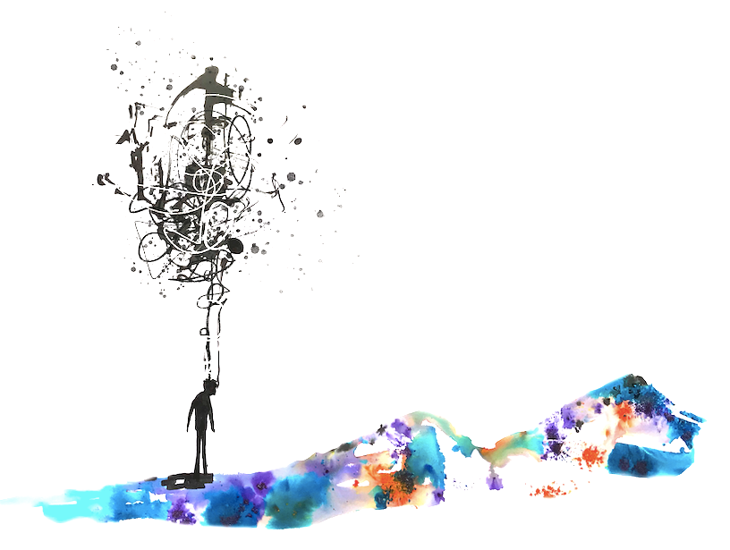
Recognising coping
Reframing and recognising so called ‘negative’ behaviours as coping.
Everyone copes differently and adopts different behaviours to keep themselves ‘safe’ in an ‘unsafe’ world. Start by asking ‘what’s right?’ about these behaviours to understand how they work for someone before thinking about alternatives.
When I am walking home at night I walk really fast and keep checking over my shoulder as I am fearful of being attacked. I feel weak and powerless.
When I am walking home at night, I walk briskly and maintain a ritual of scanning the area around me so that I can monitor the threat level and respond to it quickly./

Slide 52
A note on managing risk
Trauma informed approaches to managing risk and safeguarding
Key principles:
Provide choices wherever possible to restore a sense of control
Support coping (take the time to understand the impact and consider what is needed)
Connect someone with sources of support
Remaining engaged (even when referring to another service or professional)
Honesty and openness, wherever possible
Explaining actions (saying sorry)
/

Slide 53
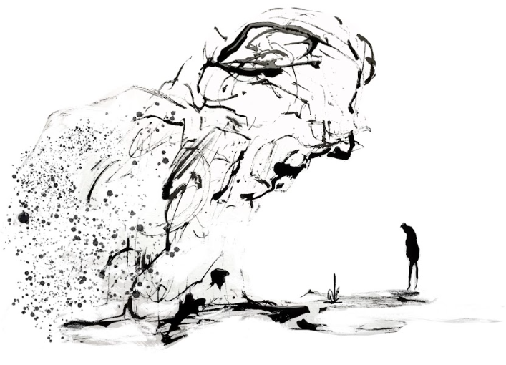
Trauma informed approaches to ‘humanitarian crisis’: Understanding context

Slide 54
What is a ‘humanitarian crisis’?
Humanitarian crises refers to an event or set of events that threaten the health, safety and livelihoods of a large number of people.
Humanitarian crises can be divided into the following:
Man-made emergencies such as conflict and industrial accidents.
Disasters such as tsunamis, earthquakes, floods, droughts, cyclones, hurricanes and health-related epidemics.
Complex emergencies, which are a combination of both natural hazards and man-made emergencies such as food insecurity and displacement of people.
(Action Aid, 2022)

Slide 55
Understanding the impact of conflict
Death, injury and disability
Sexual violence
Malnutrition and illness
Destruction of physical infrastructure (loss of home, heritage, history and identity)
/

Slide 56
Understanding the impact of conflict
Leaving family behind
Disruptions to education and employment
The challenge of accessing education
Loss of possessions and pets
Missing home and waiting to go home
Waiting for ‘peace’ and difficulties in making decisions about the future
Guilt, compassion fatigue and burnout
Living with people you would not otherwise have lived with
Hate and anger
Disenfranchised experiences (not feeling entitled to support)
Vicarious trauma ‘it could have been me’
The traumatising impact of the media
No access to bank accounts or savings
/

Slide 57
Understanding trauma and loss
There are multiple losses in the context of a humanitarian crisis:
Loss of home and possessions
Loss of a way of life
Loss of identity and nationality
Loss of employment
Loss of contact with family and friends
Loss of life
/

Slide 58
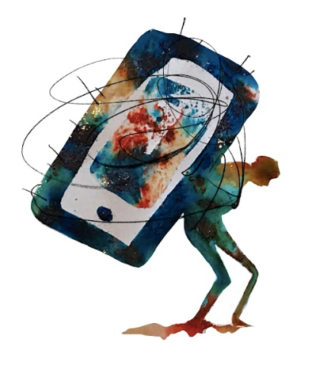
Understanding context: the role of the media
Media and social media coverage are useful in validating experiences
However, lack of media coverage can have the opposite effect and serve to disenfranchise experiences instead
Media coverage also creates the potential for traumatisation, retraumatisation and vicarious trauma
It is important to consider the disparities between conflicts and those conflicts which have been forgotten altogether (the ‘Charing Cross Experience’, ‘Rwanda’ and ‘Free Travel for Ukrainians’).

Slide 59
Engaging with the media: guidance
Seeking to understand how it is and isn’t helpful. What does it provide? What is its effect?
Are there other ways for them to find out or get what they need?
How else might you support them to regain a sense of control?
Remember there is no right or wrong. It is about understanding what works for someone and supporting them to cope with this.

Slide 60
Working with interpreters: challenges and opportunities
Providing support via an interpreter can be challenging and you will likely need to work harder to establish a sense of connection and ensure that someone feels ‘safe’ and supported within this space.
Often acknowledging these challenges can be a good starting point.
Offering the person a choice about how best to manage this and understanding their preferences will help to create a sense of safety and restore control - for example, would they prefer to speak to you directly or to the translator? do they have a preference about gender or background of the interpreter? where would they like them to sit?
Accounting for the additional time that may be needed is also important to make sure that the quality of support that is offered is not compromised.

Slide 61
Working with interpreters: challenges and opportunities
However, working with interpreters can also provide other opportunities. For example:
An insight into cultural aspects which you were not aware of
Cultural perspectives or understanding of a situation
Additional time and space to formulate responses

Slide 62
Working with interpreters: guidance
Wherever possible try to ensure consistency (whilst offering a choice to the person about their preferences)
Provide them with information about your approach and the purpose of the meeting (they will be able to help you get what you need)
Encourage them to seek clarification if needed
Provide them with information about using a trauma informed approach so that they might also adopt this in their practice
Look after them!
Further guidance: Working with interpreters - Guidelines for psychologists

Slide 63
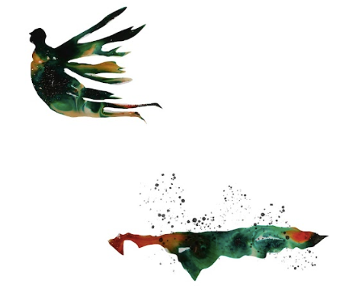
Understanding resilience
“No one escapes pain, fear and suffering. Yet from pain can come wisdom, from fear can come courage, from suffering can come strength-if we have the virtue of resilience”.
Eric Greitens
/

Slide 64
Understanding resilience
Characteristics of resilience:
Sense of control. Feeling as though you have the power to make choices that affect your situation, your ability to cope and the future. Identifying and connecting with what lies within your control. (i.e. engagement with the media, taking physical safety precautions)
Strong social connections and access to support. Being resilient doesn’t mean not needing support from others. In fact, it means knowing when and how to access this support.
Problem-solving skills. Knowing what problems you can solve and being creative, flexible and adaptable to solve them.
Emotional regulation. Developing self-awareness - the ability to recognise emotional responses and to understand what is causing them to support coping.
Self-compassion. The permission to take a break and accept emotions./

Slide 65
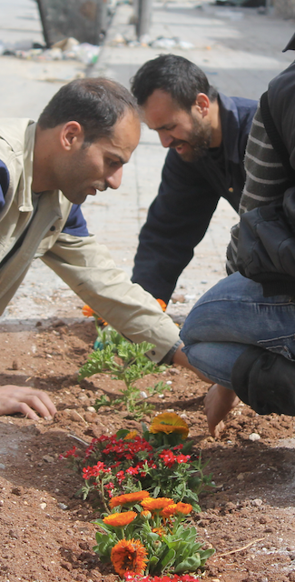
post-traumatic growth
A greater appreciation of life: appreciating the value of life, or appreciating each day in a way you didn’t before
Improved relationships with others: you might develop a sense of closeness with others, increased compassion, or the knowledge that you can count on others in times of crisis
New possibilities: such as developing new interests, a new life path, or a willingness to change things that need changing
Personal strength: the knowledge that you can handle difficult things, that you’re stronger than you thought, or an increased sense of self-reliance
Spiritual change: A deeper understanding of spirituality, or stronger faith than before
Tedeschi and Calhoun (1996)

Slide 66
Supporting others: making sense of trauma
Stabilisation:
Addressing someone’s immediate support needs (practical and emotional)
Education:
Providing them with information about the impact of trauma.
Normalisation:
Using this information to provide reassurance that someone is coping and responding normally (this in turn reduced overwhelm and the ‘power’ of these symptoms)
Supporting coping:
Focus on how someone is coping and think about what they need to enhance their capacity to cope. What is helpful to them?
Engagement:
Be proactive in engaging them with other sources of support. Don’t only focus on psychological support, but also other activities which may support coping.

Slide 67
Supporting others: guidance
Bearing witness to distress and remaining present
Understanding what you need to do versus what they might need you to do
Start by asking what someone needs. When someone isn’t able to tell you what they need, offer choices, often people can tell you what they don’t need.
Remember that everyone responds to situations differently and it is important to take the time to understand how someone has made sense of what is happening. What does it mean to them? (Rather than thinking about what it means to you).
Managing your own sense of helplessness, overwhelm, loss and fear. Remember to take the time to look after yourselves, this puts you in a stronger position to support others.
Focus on what you can do rather than on what you can’t.
Remember that someone’s needs will change over time, keep checking and seeking feedback about your approach to support.
/

Slide 68
Creating ‘moments’
A trauma informed approach isn’t about treating trauma.
It is about creating ‘moments’ for people.
Moments of hope, optimism, understanding and connection.

Slide 69
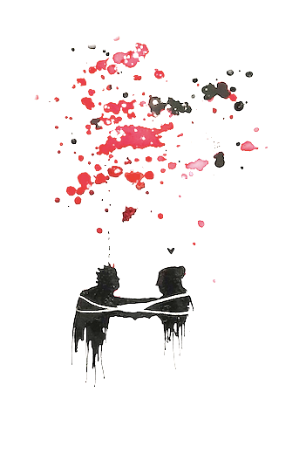
Supporting others: the impact on ourselves
Vicarious trauma is another form of traumatic stress
The effect of bearing witness to distress or hearing about experiences of trauma
Evokes strong feelings of guilt, frustration, helplessness and overwhelm
Shatters our own assumptions of the world around us (everything we thought that we knew about our world has changed)
/

Slide 70
developing resilience: Therapeutic activity
Think about your ‘trauma jar’
How full is it?
What would help to empty it out?
Think about the things in your life which support you to cope
This can include:
people
places
activities
animals
affirmations/quotes

Slide 71
Compassionate self-care
“With self-compassion, we give ourselves the same kindness and care we’d give to a good friend”
Dr Kristin Neff

Slide 72
Practical activity: give yourself a ‘self-compassion break’
Think of a situation in your life that is difficult, that is causing you stress. Call the situation to mind, and see if you can actually feel the stress and emotional discomfort in your body.
Now, say to yourself:
1. This is a moment of suffering
That’s mindfulness. Other options include:
This hurts.
Ouch.
This is stressful.
2. Suffering is a part of life
That’s common humanity. Other options include:
Other people feel this way.
I’m not alone.
We all struggle in our lives.
Creating and connecting to ‘self-kindness’
Say to yourself:
3. May I be kind to myself?
What do I need to hear right now to express kindness to myself?

Slide 73
Practical activity: give yourself a ‘self-compassion break’
Now take a square piece of paper of any size and write down what you need to hear to be kind to yourself.
You can create a square piece of paper from an A4 sheet:
Take a single sheet of paper. This can be of any size but standard size is A4
Hold the top right corner of the paper and fold it towards the lower left side. Bring it down until the paper forms into a right-angled triangle.
Cut or rip this section below the triangle
Unfold.

Slide 74
Open your heart to self compassion
Place your square in front of you with the writing face down.
Follow the instructions in the video attached to make yourself a beautiful paper heart!
Making an origami heart

Slide 75
The gift of time for self-care

Slide 76
achieved

Slide 77
QUESTIONS

